Slide 1

And the Name …

Slide 2


ByteFrost

Slide 3
ByteFrost Addressing Modes
There are four forms of memory in the ByteFrost – Immediates (read-only), General-Purpose Registers (R0 – R3), Address Registers (DP, SP, PC), and Memory (64KB divided into ROM, RAM, and MMIO regions)
Every solid directed edge (u, v) in the following graph means that memory u can write to memory v with a dedicated instruction.
Every dotted directed edge (u, v) means that the memory u can write to memory v indirectly (i.e., a path exists from u to v but requires multiple instructions to implement).
There are technically 4 x 4 = 16 possible permutations here, but as immediates are read-only, there are in effect only 3 x 4 = 12 possible permutations.
Instructions with an asterisk (*) are currently not implemented.
Immediate
Memory
LMA, LMR, LMO*
LDR
General Register
MVA*
Address Register
Dest | Src | Form
GR | Imm
GR | GR
GR | AR
GR | Memory
MOV
Dest | Src | Dedicated Instruction? | Form(s)
GR | Imm | Yes (LDR) | Rd = Imm_8 (LDR Rd, Imm)
GR | GR | Yes (MOV) | Rd = Rs (MOV Rd, Rs)
GR | AR | Yes (MVA*) | Rd = AR[i][L/H] (MVA Rd, %L/RAR)
GR | Memory | Yes (LMA, LMR, LMO*) | (LMA) Rd = *{%HDP, Imm} (LMR) Rd = *{%HDP, Rs} (LMO) Rd = *(AR[i] + Imm)
Dest | Src | Form
GR | Imm
GR | GR
GR | AR
GR | Memory

Slide 4
ByteFrost V2.0 – 16bit Address

Slide 5
Unified Bus Operation (v2.0)
8b→16b
16bitAdder
8 msb
Addr H
Data Bus
Address Bus + Read/Write
8 lsb
Addr L
Data Bus
TmpAR
Data Bus
TmpAR
3msb
AMAP
Decoder
Program Counter
PC
CE
Stack Pointer
EEPROM
SP
Data Pointer
CE
DP
SRAM
Base Pointer
BP
CE
MMIO
AR Select
Read /Write
Instruction Registers
Micro
Instructions
Register
File

Slide 6
ByteFrost Addressing Modes
There are five forms of memory in the ByteFrost – Immediates (read-only), General-Purpose Registers (R0 – R3), Address Registers (DP, SP, PC, BP), Memory (64KB divided into ROM, RAM, and MMIO regions), and Stack
Every solid directed edge (u, v) in the following graph means that memory u can write to memory v with a dedicated instruction.
Every dotted directed edge (u, v) means that the memory u can write to memory v indirectly (i.e., a path exists from u to v but requires multiple instructions to implement).
There are technically 5 x 5 = 25 possible permutations here, but as immediates are read-only, there are in effect only 5 x 4 = 20 possible permutations.
Instructions with an asterisk (*) are currently not implemented.
Immediate
Memory
LDR
MOV
General Register
Address Register
Stack
Src | Dest | Semantics | Dedicated Instruction?
Imm | GR | Rd = Imm_8 (LDR Rd, Imm) | Yes (LDR)
GR | GR | Rd = Rs (MOV Rd, Rs) | Yes (MOV)
AR | GR | Rd = ARSrc[L/H] | Yes (*)
Memory | GR | (LMA) Rd = *{%DP[H], Imm}, DP[L] = Imm (LMR) Rd = *{%DP[H], Rs}, DP[L] = Rs (LMO*) Rd = *(ARSrc + Imm) | Yes (LMA, LMR, *
Stack | GR | Rd = *(SP), SP++ | Yes (POP)
Src | Dest | Semantics | Dedicated Instruction?
Imm | AR | ARDest[L/H] = Imm | Yes (*)
GR | AR | ARDest[L/H] = Rs | Yes (*)
AR | AR | ARDest = ARSrc + Imm | Yes (*)
Memory | AR | ARDest[L/H] = *(ARSrc + Imm) (?) ARDest = *{ARSrc + Imm + 1, ARSrc + Imm} (?) | No
Stack | AR | ARDest = *{SP + 1, SP}, SP += 2 (?) (e.g. POP ARDest) | No
Src | Dest | Semantics | Dedicated Instruction?
Imm | Memory | *(ARSrc) = Imm (?) | No
GR | Memory | *(ARSrc + Imm) = Rs | Yes (*)
AR | Memory | *(ARDest + Imm + 1, ARDest + Imm) = ARSrc(?) | No
Memory | Memory | *(ARDest + Imm) = *(ARSrc) | No (load-store architecture)
Stack | Memory | *(ARSrc + Imm) = *SP, SP++ (?) | No
Src | Dest | Semantics | Dedicated Instruction?
Imm | Stack | *(SP) = Imm, SP– (Push Imm) | No?
GR | Stack | *(SP) = Rs, SP-- | Yes (PUSH *) (change to full-descending)
AR | Stack | *(SP, SP – 1) = ARSrc, SP -= 2 | No? (Push ARSrc)
Memory | Stack | ? | ?
Stack | Stack | ? | ?

Slide 7
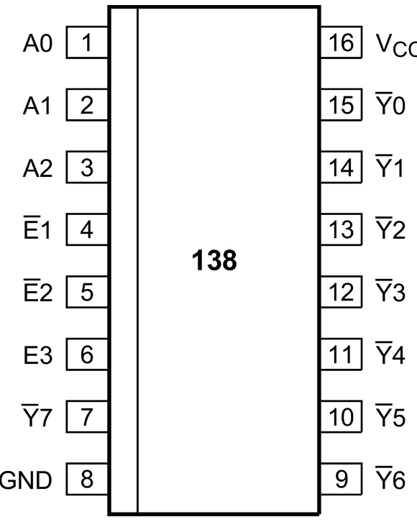
Address Bus Arbiter (v2.0)
Note: The Address Bus Arbiter Deprecated. It is replaced by the ARSelect LUT.
µC 14: SP Addr
Data Pointer OE
FetchCycle
Stack Pointer OE
Bus Grant
138: Addr Bus Arbiter
Program Counter OE
Remove
When the bus is granted to MMIO Master (SD Card) all other masters set to three state (No one transmit address on the bus)

Slide 8
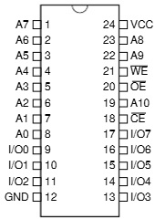
Address Bus Select (ARSelect) v2.0
ARSelect specifies which AR gets to write to the Address Bus and whether any of them do (it can do this since it only sends output enables; if it doesn’t send an output enable to any hardware entity, then no entity writes to the address bus).
Bus Grant
FetchCycle
µC 9: PC Out
µC 14: SP Out
TmpAR OE
µC 20: TmpARWrite
ARSelect 8x8 LUT
Opcode_MAG_LDW_SDW_MAA
ARSrc [1:0]
Temporary dangled
Program Counter OE
Data Pointer OE
Stack Pointer OE
Inputs |  |  |  |  |  |  | Outputs (Active Low)
Bus Grant (A7) | Fetch Cycle (A6) | PC Out control signal (A5) | SP Out control signal (A4) | TmpAR Write control signal (A3) | Opcode_MAG_LDW_SDW_MAA (Active Low) (A2) | AR Src operand (A1, A0)
1 | X | X | X | X | X | X | None (Bus floats)
0 | 1 | X | X | X | X | X | PC (I/O 0)
0 | 0 | 1 | X | X | X | X | PC (I/O 0)
0 | 0 | 0 | 1 | X | X | X | SP (I/O 2)
0 | 0 | 0 | 0 | 1 | X | X | TmpAR (I/O 4)
0 | 0 | 0 | 0 | 0 | MAG, LDW, SDW, MAA | AR Src[1:0] | = AR Src[1:0] 0-PC, 1-DP, 2-SP, 3-BP
0 | 0 | 0 | 0 | 0 | Other Opcodes | X | DP (I/O 0)
EEPROM Data Output Bit | Output
7 | 1 (unused)
6 | 1 (unused)
5 | 1 (unused)
4 | TmpAR Output Enable (ACTIVE LOW)
3 | BP Output Enable (ACTIVE LOW)
2 | SP Output Enable (ACTIVE LOW)
1 | DP Output Enable (ACTIVE LOW)
0 | PC Output Enable (ACTIVE LOW)

Slide 9
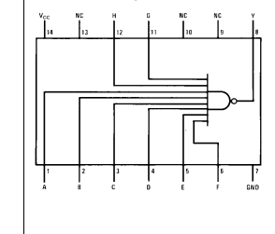

Opcode_MAG_LDW_SDW_MAA (v2.0)
LDWL
OpCode_14
LDWH
OpCode_15
74LS30
SDWL
OpCode_16
SDWH
OpCode_17
MAAL
OpCode_18
Opcode_MAG_LDW_SDW_MAA
MAAH
OpCode_19
MAG
OpCode_1A
Opcode_MAA
JSR
OpCode_10
Opcode_MAA_JSR

Slide 10
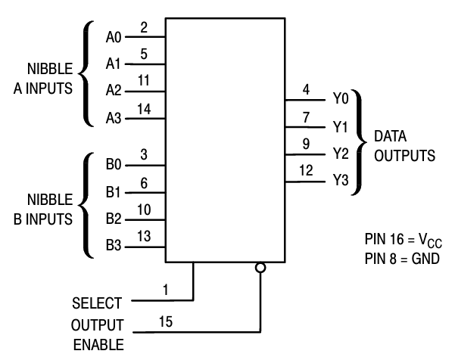
ARSrc Operand Decode v2.0
Instr[5],Instr[1]
Instr[9],Instr[8]
ARSrc Decode:
If opcode is of (AR → GR) (Rd = ARSrc[L/H]) instruction, then ARSrc is in bits 9:8.
Otherwise, ARSrc is a function of bits 5 and the opcode (maybe the opcode’ least significant bit?)
Instructions that specify ARSrc with 1 bit in bit 5 need to get the other bit from the opcode; if we always assign these two-opcode instructions opcodes as [4-bit opcode x][0/1], then we can get the other ARSrc bit from the least significant bit of the opcode, i.e., in these instructions ARSrc is {Instr[5], Instr[0]} (in bits 5 and 0)
Instr[9],Instr[8]
157: ARSrc
ARSrc [1:0]
Instr[5],Instr[1]
OpCode_MAG
0v

Slide 11
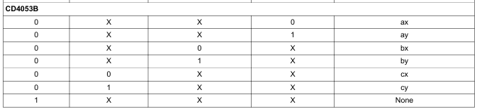
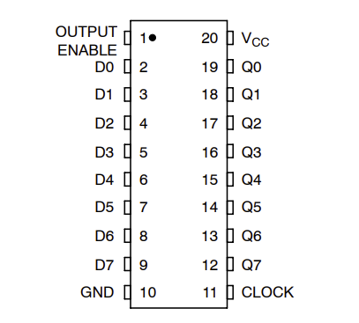
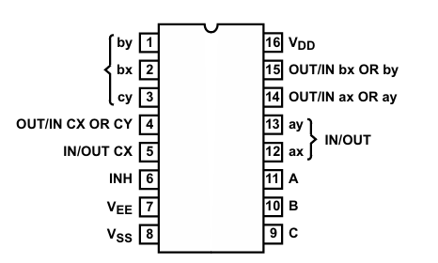
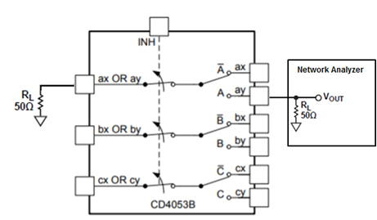
Address to Data Bus
Data Bus
Data
[7:0]
Address Bus
Data
[7:0]
Main CLK
574: Addr Hi
574: Addr Lo
Addr Hi
[15:8]
Addr Hi
[15:8]
µC 21: AB2DB
5v
0v
Addr Lo OE
0v
Addr Hi OE
AR H/L (Instr[5])
µC 21: AB2DB
µC 22: AB2DB H/L
Opcode_MAA_JSR
0
0v
Opcode_MAA_JSR
CD4053 C
Addr Hi OE
0
1
0v
µC 22: AB2DB H/L
0
0v
CD4053 A
AR H/L (Instr[5])
1
0
0
CD4053 B
Addr Lo OE
µC 21: AB2DB
1

Slide 12
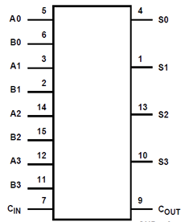
TmpAR (Address Offset Adder) v2.0
Address Bus
Addr Hi
[15:8]
Addr Low
[7:0]
Main CLK
574: TmpAR Hi
574: TmpAR Lo
Addr Hi
[15:8]
Addr Hi
[15:8]
The only control in this circuit is the TmpAR OE which
Writes to the Address bus the sum of
Address+Data from last clock
TmpAR OE
Address Bus
283: Add 3:0
283: Add 3:0
283: Add 3:0
283: Add 3:0
Data
Sign Extended
[15:8]
Data
[7:0]
Addr Hi
[15:8]
Addr Lo
[7:0]
Data Bus

Slide 13
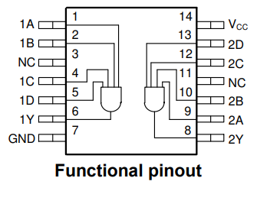
Address Map Decoder (v2.0)
Address Bus + Read/Write
~EEPROM Chip En
A15..A13
Address Map
138 AMAP
138 AMAP
74HC21
0000 – 1FFF | ROM
2000 – 3FFF | RAM
4000 – 5FFF
6000 – 7FFF
8000 – 9FFF
A000 – BFFF
C000 – DFFF
E000 – FFFF | MMIO
~SRAM Chip En
MMIO
E000 – E1FF | SD Card
E200 – E3FF | Counter
E400 – E5FF
E600 – E7FF
E800 – E9FF
EA00 – EBFF
EC00 – EDFF
EE00 – EFFF
F000 – FFFF | No HW
A9
A10
A11
~SD Card Device En
A12
138 MMIO Device Enable
~Counter Device En
74HC21

Slide 14
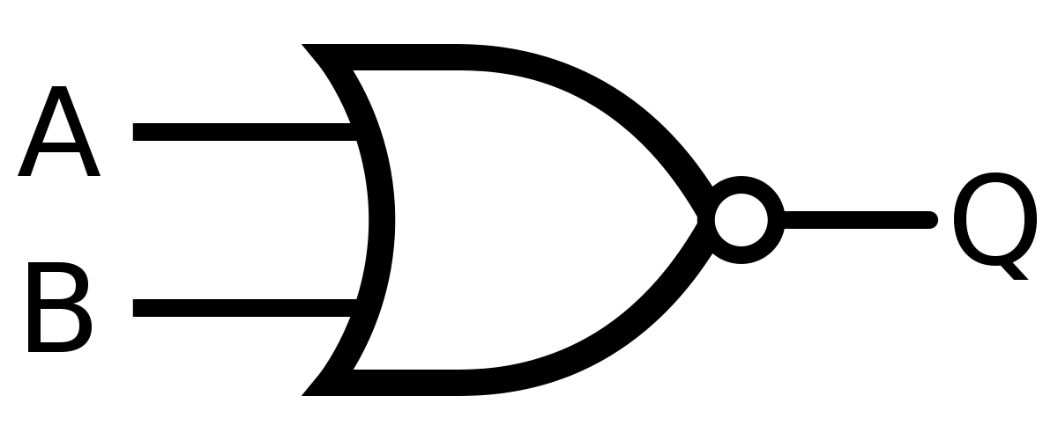
Memory Access (v2.0)
Cycle | Signal | SRAM | EEPROM | MMIO
Memory Write | #WE | #WE | ‘1’ (no writes) | #WE
Memory Read | #OE | #OE
Memory Write or Memory Read | #CE | (~SRAM Chip En) | (~EEPROM Chip En) | MMIO
µC 10: MEM Read
FetchCycle
#OE
Main CLK
#WE
µC 11: MEM Write

Slide 15


SRAM (v2.0)
Data
Bus
~SRAM Chip En
#OE
#WE
Address Bus + Read/Write
SRAM
A0..A15
I/O[0:7]
15

Slide 16

EEPROM (v2.0)
Address Bus
Addr
[15:0]
Prog EEPROM
~EEPROM Chip En
Prog
Data[7:0]
#OE
Data Bus
16

Slide 17
Load Special Pointer (LSP) (v2.0)
Note: The Load Special Pointer logic is Deprecated. It is replaced by the AR Data Bus Load Enable LUT. However, the LUT still needs to NOR its active low output enables with the CLK (exceptions: PC[L] + PC[H] = DHPC Load Enable and SP[L] Load Enable).
OpCode
[7:6] SP
Ld Prog Ctr Dummy
Ld Addr Ptr Hi
138: LSP
Ld Stack Ptr Hi
µC 17: LSP
Removed
Main CLK
Clk
138 output (inv)
NOR

Slide 18
Address Registers - Data Bus Load Enable v2.0
PC Ld Branch
µC 17: LoadAR
µC 8: PC Load
µC 18: LoadAR H/L
Opcode_MAA
BP[H] Ld En
Opcode_5
AR DB LE 8x8 LUT
Opcode_7
BP[L] Ld En
Opcode_6
SP[H] Ld En
SP[L] Ld En
PC Ld En
DP[H] Ld En
Main CLK
DHPC Ld En
DP[L] Ld En
EEPROM Address Bit | Input
7 | PC Load Branch (ACTIVE LOW)
6 | loadAR (control signal)
5 | PC Load (control signal)
4 | loadARHorL (control signal)
3 | Opcode_MAA (ACTIVE LOW)
2 | (AR) L/H instruction operand
1 | ARDest[1]
0 | ARDest[0]
EEPROM Data Output Bit | Output
7 | BP[H] Load Enable (ACTIVE LOW)
6 | BP[L] Load Enable (ACTIVE LOW)
5 | SP[H] Load Enable (ACTIVE LOW)
4 | SP[L] Load Enable (ACTIVE LOW)
3 | DP[H] Load Enable (ACTIVE LOW)
2 | DP[L] Load Enable (ACTIVE LOW)
1 | DHPC Load Enable (ACTIVE LOW)
0 | PC[L] + PC[H] = DHPC Load Enable (ACTIVE LOW)

Slide 19
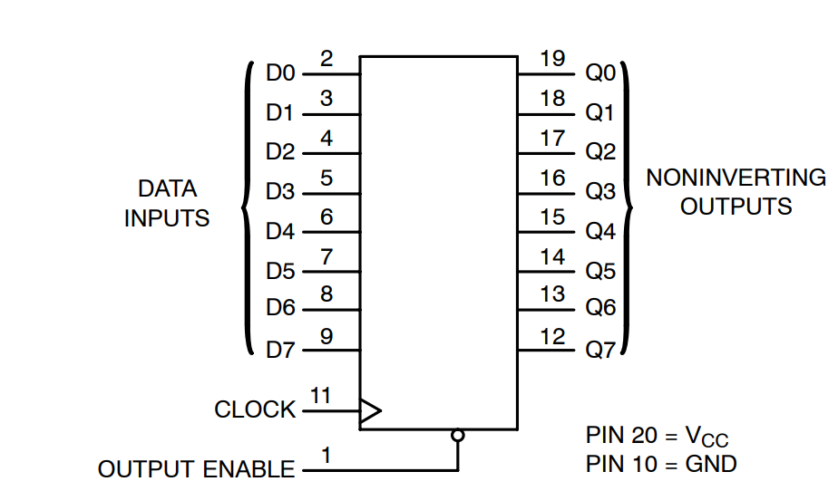


Program Counter (v2.0)
Prog Counter 14:0 are mapped to Address Bus 15:1.
“INC Prog Counter” is mapped to Address Bus bit 0
Relative Branch only update PC 7:0, or Address bus 8:1
Absolute Branch, JSR, RTS use the PC Dummy Reg
PC bit 15 is not used
DHPC Ld En
Data Bus
574: Prog Ctr
Dummy
Data
[7:4]
Data
[3:0]
Main CLK
PC High
[14:8]
~Main Reset
74HC161 PC[14:12]
74HC161 PC[11:8]
74HC161 PC[7:4]
74HC161 PC[3:0]
Address Bus
PC
[7:4]
PC
[3:0]
PC Ld En
Note: The PC Loading and output logic is Deprecated.
The PC may not write directly to the Data Bus (remove Read PC Low).
PC Ld Lo and Hi are deprecated, replaced by AR Data Bus Load Enable’s PC[L] + PC[H] = DHPC Load Enable (which goes to both PC[H] and PC[L]).
Ld Prog Ctr Dummy is deprecated, replaced by AR Data Bus Load Enable’s DHPC Load Enable (which must be NOR’d with the CLK signal).
PC High[14:8]
PC Low[7:0]
INC Prog Counter
[0]
74HC245
74HC245
PC[14:8] → Addr[15:9]
INC → Addr[0]
PC[7:0 ]→ Addr[8:1]
Addr Hi
[15:9, 0]
Addr Low
[8:1]
Program Counter OE
19

Slide 20
Load PC High (v2.0)
Note: The Load PC High logic is Deprecated. It is replaced by AR Data Bus Load Enable’s PC[L] + PC[H] = DHPC Load Enable signal.
Removed
Branch Absolute
OpCode_05
JSR
OpCode_10
PC Ld Hi
RTS
OpCode_11

Slide 21
Data Pointer (v2.0)
Note: Address Pointer Lo’s clock gating is Deprecated. It is replaced by AR Data Bus Load Enable’s DP[L] Load Enable (which needs to be NOR’d with the clock signal). Control Signal 12 may be removed (? – check which instructions need it).
Address Bus + Read/Write
Note: Ld Addr Ptr Hi is Deprecated. It is replaced by AR Data Bus Load Enable’s DP[H] Load Enable (which needs to be NOR’d with the clock signal).
Data
Bus
A15..A8
A15..A8
574: Addr Ptr Hi
Note: Data Pointer OE is Deprecated. It is replaced by ARSelect’s DP Output Enable.
Done
DP[H] Ld En
A7..A0
574: Addr Ptr Lo
A7..A0
DP[L] Ld En
Data Pointer OE
Clk
!Clk
Control
AND
21

Slide 22
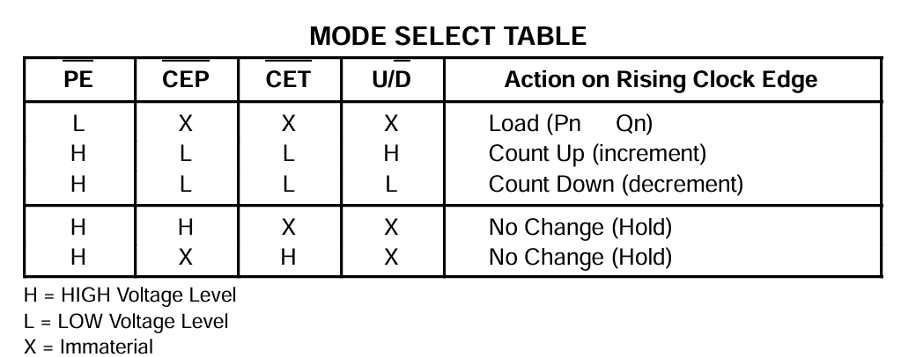
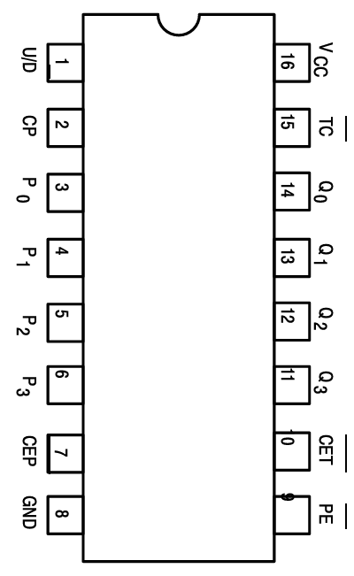
Stack Pointer (v2.0)
Address Bus + Read/Write
A15..A8
574: Stack Ptr Page
SP[H] Ld En
Data
Bus
µC 16: SP Up/Down
SP 7:4
Main CLK
169: U/D 4bit
A7..A4
µC 15: SP Count
A7..A0
245: 3-State
A3..A0
SP 3:0
169: U/D 4bit
SP[L] Ld En
Stack Pointer OE
22

Slide 23



Fetch State Machine (v2.0)
Prog
Data[7:0]
273 Lo
FetchCycle
µC 7: PC Advance
OpCode
[4:0]
OpCode
[7:5] Flags
OpCode
[7:6] Rd RO
OpCode [5] A/I
Main CLK
OpCode
[7:6] Rd RI
Prog
Data[7:0]
175
273 Hi
MR
H Reg
8 bits
OpCode
[15:12]
# Bus Grant
# Reset_microPC
# Main Reset
INC Prog Counter
Quiesce
Extend Quiesce
MSB_Quiesce
23

Slide 24
Sharing the Data and Address Buses during Fetch Cycle
Last Instruction
Next Instruction
Control signals
Last Micro instruction
PC Advance
Addr+1
Inst address A8=1
Micro
instruction 0
Micro
instruction 1
Address Bus
Program Counter
Low addr
Program Counter
High addr
Data Bus
Ld Low Instruction
Next Instruction High byte
Next Instruction Low byte
Ld Instruction
Ld High Instruction
Clock
Micro Instruction 0 controls the buses
First clock of the next instruction, buses are used to load the high byte of the instruction. To avoid transmission of the first micro instruction on the buses, the micro instruction address bit A8 is set, and all control signals are set to 0, avoiding any transmission on the busses
Last clock of an instruction includes the PC_Advance.
In that clock, the Address and Data buses are used by the Program Counter. No other signal using the address or data buses is allowed.

Slide 25
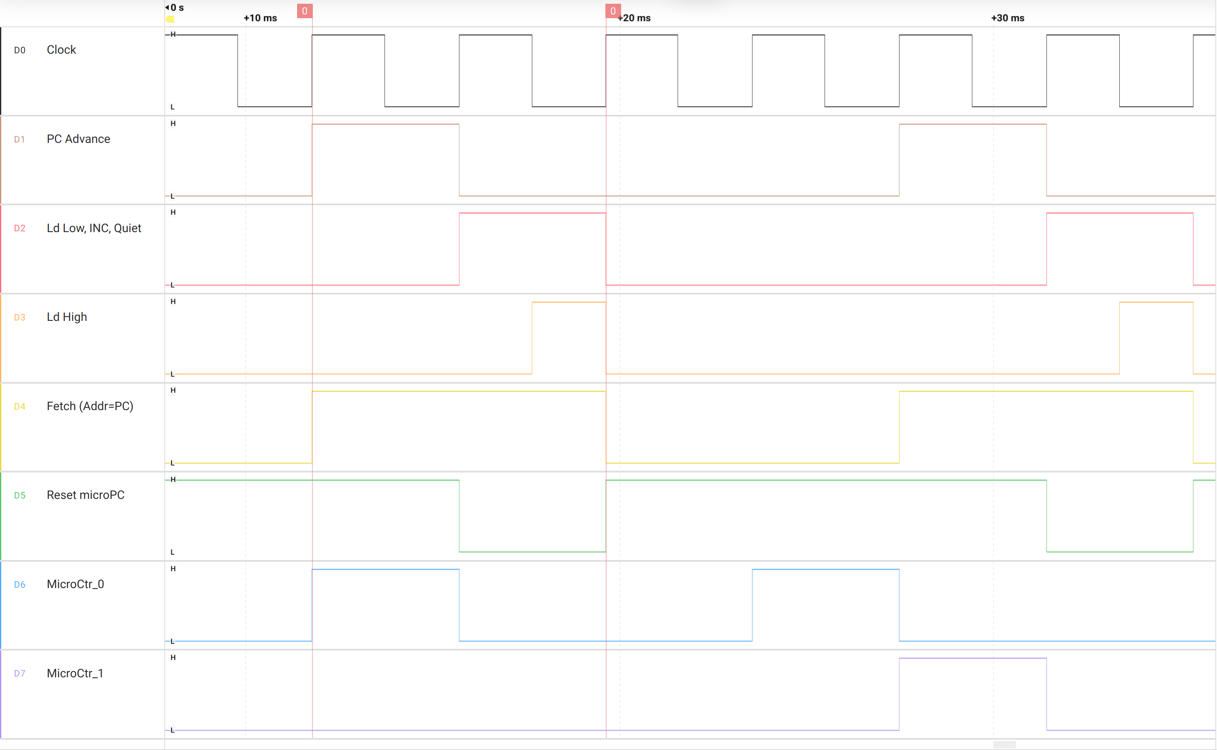
PC Advance - Logic Analyzer
PC Advance
Ld Low (rising)
INC, Quiesce
Ld High
(from INC)
Address Bus controlled by Prog Count
Reset Micro Instruction Ctr
CTR=0
CTR=0
CTR=1
CTR=2

Slide 26
Bus Arbitration for I/O
Normal
CPU owns buses
MMIO Buses Request
No change
CPU owns buses till end of instruction
MMIO Buses Granted
CPU does not transmit on
Address bus
Data bus
Micro instruction controls
Microinstruction counter held in reset
MMIO request
End of
Micro instruction
Bus Release
Requested
175
1
3
1
3
Bus Request
2
2
Extend Quiesce
4
6
5
Bus Grant
5
6
12
Quiesce
4
13
11
# Bus Release

Slide 27

Micro Instructions EEPROMs (v2.0)
µC 23:
µC 15: SP Count
µC 7: PC Advance
µC 22: AB2DB H/L
µC 14: SP Out
µC 6: Out Reg H
µC 21: AB2DB
µC 13: Reg Out Rd
µC 5. Reg In En
µC 5. Reg In En
µC 20: TmpARWrite
µC 12: Ld Data Addr
µC 4: Reg Out En
µC 4. Reg Out En
µC 19: ?
µC 11: MEM Write
µC 3: Reg Out Select
µC 18: LoadAR H/L
µC 10: MEM Read
µC 2: ALU Out En
µC 2. ALU Out En
µC 17: LoadAR
µC 9: PC Out
µC 1: ALU Load A
µC 16: SP Up/Down
µC 8: PC Load
µC 0: ALU Load B
1,0,0,0,0,0,0,0
1,0,0,0,0,0,0,0
1,0,0,0,0,0,0,0
MSB_Quiesce
Set A8 to quiesce all controls during the first clock while upper OpCode is loading
Micro Ins 16_23
Micro Ins 8_15
Micro Ins 0_7
0,0
0,0
0,0
3 bit
3 bit
3 bit
5 bit
5 bit
5 bit
3 bit
Counter A2..A0
Opcode A7..A3
OpCode
[4:0]
# Reset_microPC
161
Main CLK
27

Slide 28
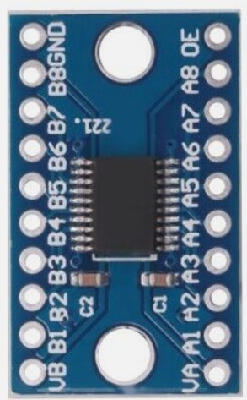
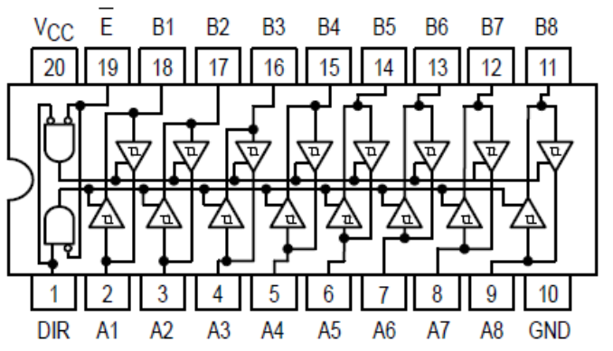
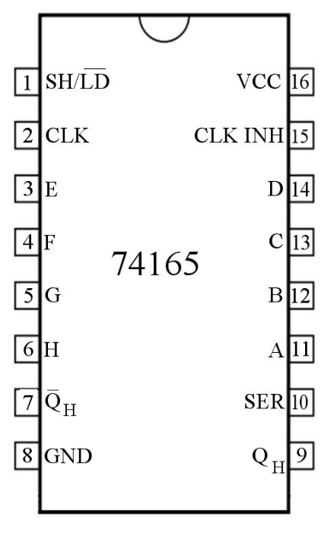
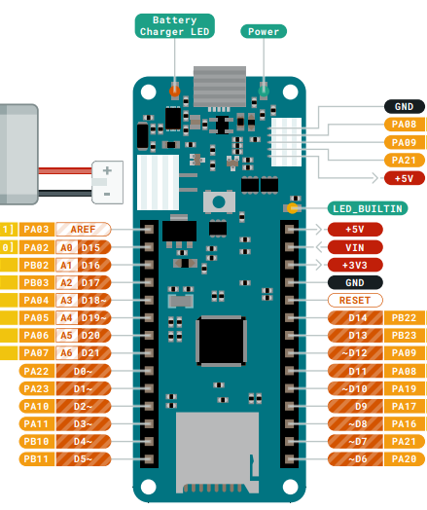
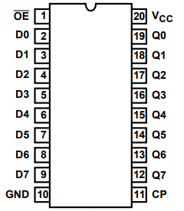
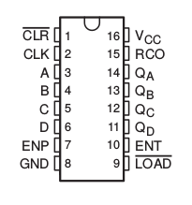
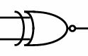
SD Card – Page Load / Store
Operation | ReadRAM# | WriteRAM# | Addr_En# | Dat_ dir | SRAM OE# | SRAM WE#
Idle | 0 | 0 | 1 | N/A | N/A | N/A
RAM → SD | 0 | 1 | 0 | In | 0 | 1
SD → RAM | 1 | 0 | 0 | Out | 1 | 0
Idle | 1 | 1 | 1 | N/A | N/A | N/A
Address | R/W | Register
Base Addr | W | Addr Hi
+1 | W | Sector Hi
+2 | W | Sector Lo
+3 | W | Go
8-bit data bus
Data bus
Data bus
HC245 Data Out
WriteRAM#
165 Sector Hi
Addr_en#
165 Sector Lo
Addr_en#
574 Addr - High
Addr 15:8
165 Sector Hi
6
7
8
9
10
11
12
13
14
RESET
GND
VCC (3.3v)
VIN (5v)
5V
# Bus Release
Ld Sector
Load Addr Hi
17 – ReadRAM#
16 – WriteRAM#
~SD Card Device En
3.3v – 5v
bi-directional
level shifters
138 Decoder
#WE
Addr_en#
Addr 2:0
7:4 Ctr
Addr 7:4
# Main Reset
Addr_en#
XNOR
1
2
3
4
5
6
7
8
1
2
3
4
5
6
7
8
HC245 Addr Out
12 - Shift
3:0 Ctr
Addr 3:0
11 - Serial_IN
10 – RESET Counters
9 - CNT/CLK
8 - GO_INT
Bus Grant
Bus Request
28

Slide 29
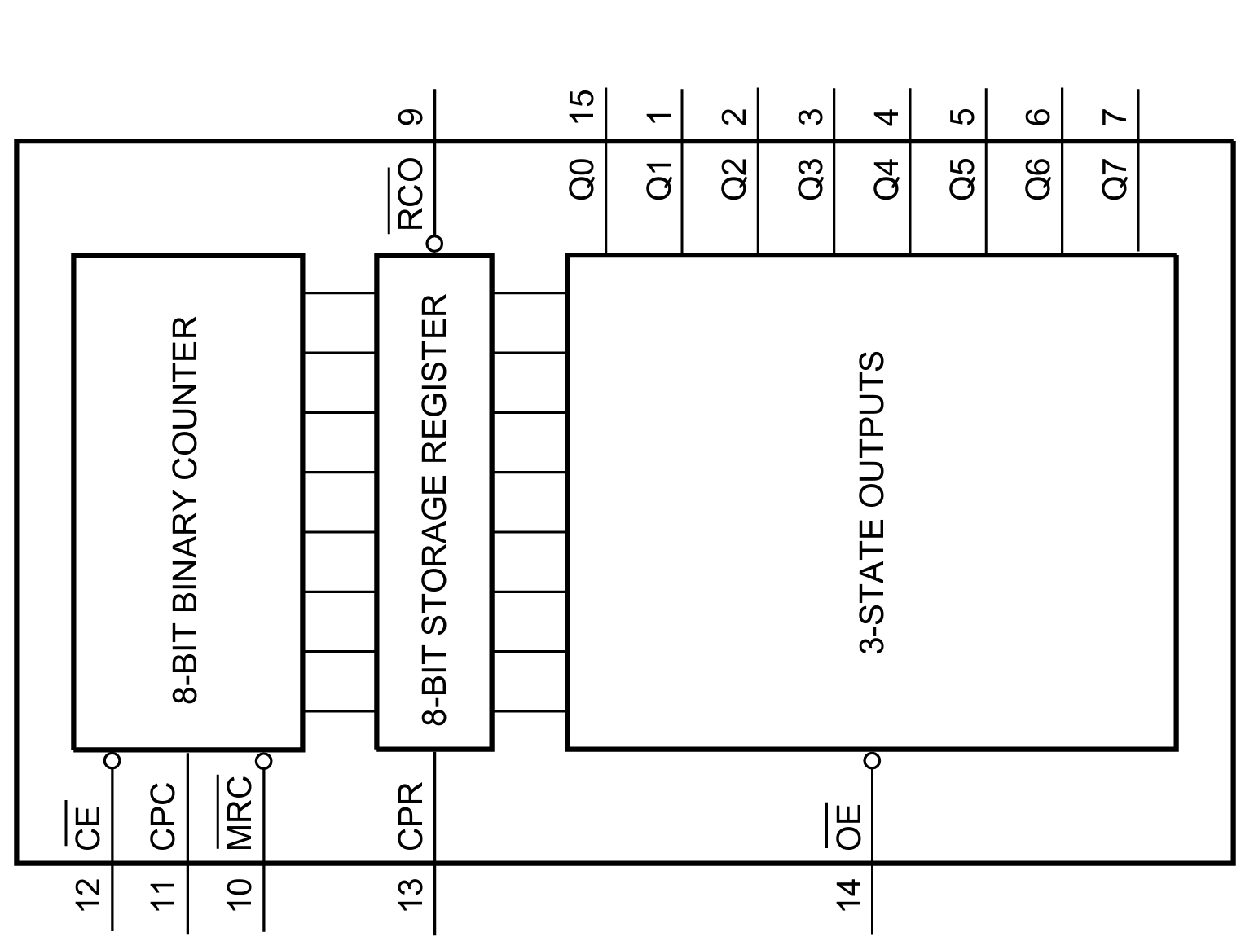
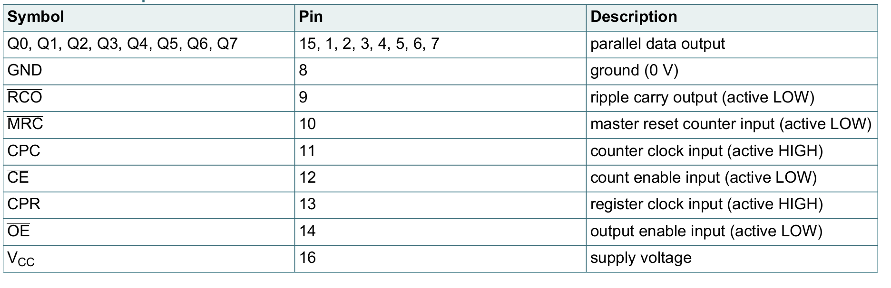
Counter (v2.0)
Data Bus
Address | R/W | Register
Base Addr | W | Reset Counter
+1 | W | Latch Counter
+2 | R | Read Counter 0
+3 | R | Read Counter 1
+4 | R | Read Counter 2
+5 | R | Read Counter 3
74HC590 Counter
Addr 2:0
MRC: Reset Counter
#WE
Write Decoder
CPR: Latch Counter
74HC590 Counter
~Counter Device En
Addr 2:0
#OE
Read Decoder
74HC590 Counter
74HC590 Counter
74HC590 Counter

Slide 30

OpCode Decoder (v2.0)
MAAL
JSR
OpCode_08
Out Reg
OpCode_1
BRK
OpCode_18
OpCode_10
OpCode_19
MAAH
OpCode_11
RTS
OpCode_MAG
1A
OpCode_0D
Out Imm
OpCode_05
Branch Absolute
OpCode_1B
LDA
OpCode_6
ALU Immediate
OpCode_1C
MGA
OpCode_7
Branch Relative
OpCode_1D
Unused
OpCode_1E
Unused
OpCode_1F
Unused
74HC138
OpCodes 24-31
74HC138
OpCodes 16-23
74HC138
OpCodes 8-15
74HC138
OpCodes 0-7
0
1
2
0
1
2
‘0’
0
1
2
‘0’
0
1
2
‘1’
‘0’
‘0’
0
1
2
3
4
OpCode
[4:0]
30

Slide 31
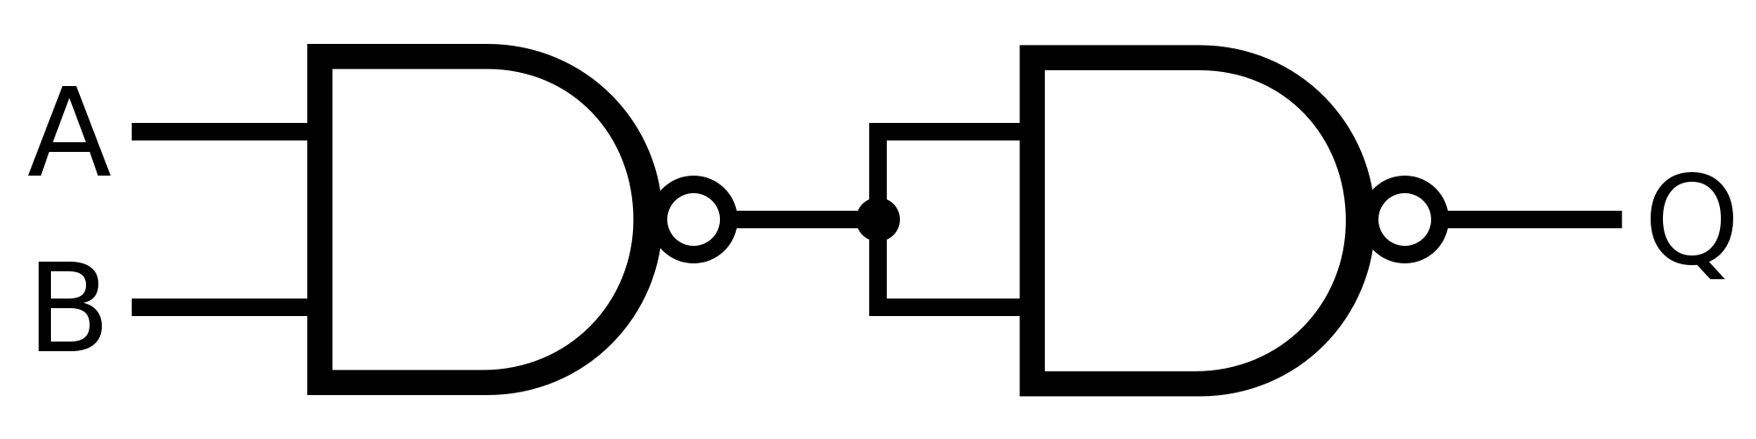
ALU Interface – Flags, A,B Registers, Op Code selection (v2.0)
Clock
MR
ALU
Clk
µC 1: ALU Load A
A_I
A
Clk
µC 0: ALU Load B
74HC161
Data
Bus
74HC161
Branch Relative
OpCode_7
Gray
4b’0110 (ADD)
0
74HC161
ALU OpCode
B
74HC157
74HC161
4b from H reg[3:0]
1
µC 2. ALU Out En
Data Bus
74HC251
C
Don’t update flags on BR relative
Parallel Load Enable
Flags
74HC161
Flags
Notes: Registers A and B are implemented by two HC161s, each stores 4 bits as the typical HC273 and HC347 won't fit into the 16pin sockets on the ALU wireup board.
The branch relative instruction doesn’t update flag bits to avoid corrupting the flag register state when executing a branch instruction (which may occur due to the ADD operation performed)
Carry In

Slide 32


Branch (v2.0)
Note: PC Ld Lo is renamed to PC Load Branch.
OpCode
[7:5]
Instruction LSB
Q7 Q6 Q5
µC 8: PC Load
D4
D5
D6
D7
‘1’
‘N’
PC Ld Branch
74HC151
‘C’
74HC161
Flags
‘Z’
C2 | C1 | C0 | Condition | Instruction LSB | Equivalent Assembly Instruction
0 | 0 | 0 | JMP | 05 | JMP
0 | 0 | 1 | N | 25 | BMI – Branch on Minus
0 | 1 | 0 | C | 45 | BCS – Branch Carry Set
0 | 1 | 1 | Z | 65 | BEQ – Branch Equal
1 | 0 | 0 | Never | 85 | NOP
1 | 0 | 1 | !N | A5 | BPL – Branch on Plus
1 | 1 | 0 | !C | C5 | BCC – Branch Carry Clear
1 | 1 | 1 | !Z | E5 | BNE

Slide 33
Instruction set (v2.0)
Op code | Instruction | Details
0x00 | NOP | No operation
0x01 | BRK | Halt the program
0x02 | ALU (Format ALU Rd, Rs1, Rs2) | ALU instruction (OR, AND, XOR, NOT, ADD, SUB, ASL, ROL, LSR, ASR, ROR, ADC, SBC)
0x03 | LDR | Load Register from immediate
0x04 | MOV | Copy Register (MOV instruction in ARM)
0x05 | Branch Absolute | Jump to an address (8bit)
0x06 | ALU Immediate (Format: ALU Rd, Rd, imm) | ALU instruction with value from immediate
0x07 | BRANCH Relative | Relative Branch (+127 to -128)
0x08 | OUT register | Print a register as a character or integer
0x09 | LMA | Load register from address
0x0A | SMA | Store register to address
0x0B | LMR | Load register from address in another register
0x0C | SMR | Store register into an address in another register
0x0D | OUT Immediate | Print the immediate next byte as a character or integer
0x0E | PUSH
0x0F | POP
0x10 | JSR | Jump Subroutine, store current PC in stack
0x11 | RTS | Return Subroutine, Load PC from stack
0x12 | TST Registers | Compare registers
0x13 | TST Register | Compare register and immediate
0x14 | LDW1 | Load Data Byte with Offset 1 (PC or SP)
0x15 | LDW2 | Load Data Byte with Offset 2 (DP or BP)
0x16 | SDW1 | Store Data Byte with Offset 1 (PC or SP)
0x17 | SDW2 | Store Data Byte with Offset 2 (DP or BP)
0x18 | MAA1 | Move Address with Offset to Address 1 (PC or SP)
0x19 | MAA2 | Move Address with Offset to Address 2 (DP or BP)
0x1A | MAG | Move Address to General register
0x1B | LDA | Load Address register
0x1C | MGA | Move General to Address register
Covered by BIST
Completed
Planned
Deprecating
33

Slide 34
ALU with changes
Op Select | Special Func. = 0 |  | Special Func. = 1 |  | Flag in | Flags Out
0 | A OR B | OR: 0 | A OR B |  | - | Z, N
1 | A AND B | AND: 2 | A AND B |  | -
2 | A XOR B | XOR: 4 | ~B | NOT: 5 | - | Z, N
3 | A + B | ADD: 6 | A – B | SUB: 7 | - | Z, N, Co
4 | Shift Left A A[0]=0 | ASL: 8 | Rotate left A A[0]=Cin | ROL: 9 | Cin (Rotate) | Z, N=A[6], Co=A[7]
5 | Shift Right A | LSR: A | Arithmetic S.R. A | ASR: B | - | Z, N, Co=A[0]
6 | Rotate Right | ROR: C | Cin -> A-> Cout |  | Cin | Z, N, Co=A[0]
7 | A + B + Cin | ADC: E | A – B + Cin | SBC: F | Cin | Z, N, Co
Proposal | # of IC slots | Description | Op Code
OR and ADD share Op Code (low priority) | 2x 74LS157 | Special Function select OR or AND | Release op code
Allow using ALU as two registers (low Priority) |  | Need to create output A and B
Proposals for the additional operations
How to chain Shift Right of two bytes?
34

Slide 35
Micro-Instructions Control: NOP Instruction (00000)
0
Bit | Operation
16 | Stack Pointer Increment / Decrement (0: decrease / 1: increase)
15 | Stack Pointer Count
14 | RAM Address Select (0: Address register / 1: Stack pointer)
13 | Use Rd as Source
12 | Lower Address Register Load
11 | Mem Write
10 | Mem Read
9 | PC Out
8 | PC Load
7 | PC advance
6 | Program Register H Write to Bus (parameter)
5 | Register File Input Enable
4 | Register File Output Enable
3 | Register File Output Select (parameter – 0 -> Rs1, 1 -> Rs2)
2 | ALU output enable
1 | ALU load register A
0 | ALU load register B
Bit | Operation
17 | Load Special Register
16 | Stack Pointer Increment / Decrement (0: decrease / 1: increase)
15 | Stack Pointer Count
14 | RAM Address Select (0: Address register / 1: Stack pointer)
13 | Use Rd as Source
12 | Lower Address Register Load
11 | Mem Write
10 | Mem Read
9 | PC Out
8 | PC Load
7 | PC advance
6 | Program Register H Write to Bus (parameter)
5 | Register File Input Enable
4 | Register File Output Enable
3 | Register File Output Select (parameter – 0 -> Rs1, 1 -> Rs2)
2 | ALU output enable
1 | ALU load register A
0 | ALU load register B
Cycle # | Instruction | Explanation
0 | 00000000 = 0x00
1 | 10000000 = 0x80 | Increment PC
2
3
4
5
6
7
NOP
Type | 15 14 | 13 12 | 11 10 9 8 | 7 6 | 5 | 4 3 2 1 0
None | XX | X | XXXX | XX | X | OpCode=00
35

Slide 36
Micro-Instructions Control: BREAK (00001)
1
Bit | Operation
16 | Stack Pointer Increment / Decrement (0: decrease / 1: increase)
15 | Stack Pointer Count
14 | RAM Address Select (0: Address register / 1: Stack pointer)
13 | Use Rd as Source
12 | Lower Address Register Load
11 | Mem Write
10 | Mem Read
9 | PC Out
8 | PC Load
7 | PC advance
6 | Program Register H Write to Bus (parameter)
5 | Register File Input Enable
4 | Register File Output Enable
3 | Register File Output Select (parameter – 0 -> Rs1, 1 -> Rs2)
2 | ALU output enable
1 | ALU load register A
0 | ALU load register B
Bit | Operation
17 | Load Special Register
16 | Stack Pointer Increment / Decrement (0: decrease / 1: increase)
15 | Stack Pointer Count
14 | RAM Address Select (0: Address register / 1: Stack pointer)
13 | Use Rd as Source
12 | Lower Address Register Load
11 | Mem Write
10 | Mem Read
9 | PC Out
8 | PC Load
7 | PC advance
6 | Program Register H Write to Bus (parameter)
5 | Register File Input Enable
4 | Register File Output Enable
3 | Register File Output Select (parameter – 0 -> Rs1, 1 -> Rs2)
2 | ALU output enable
1 | ALU load register A
0 | ALU load register B
Cycle # | Instruction | Explanation
0 | 00000000 = 0x00 | Do nothing
1 | 10000000 = 0x80 | Increment PC
2
3
4
5
6
7
Note: BRK has the same microcode as NOP, but the opcode decoder halts the clock when the opcode 00001 is detected. Stepping through it manually (via Single-Step / Run button press) resumes the clock. Hence, BRK acts as a hardware breakpoint.
BRK
Type | 15 14 | 13 12 | 11 10 9 8 | 7 6 | 5 | 4 3 2 1 0
None | XX | X | XXXX | XX | X | OpCode=01
36

Slide 37
Micro-Instructions Control: ALU (00010)
2
Bit | Operation
16 | Stack Pointer Increment / Decrement (0: decrease / 1: increase)
15 | Stack Pointer Count
14 | RAM Address Select (0: Address register / 1: Stack pointer)
13 | Use Rd as Source
12 | Lower Address Register Load
11 | Mem Write
10 | Mem Read
9 | PC Out
8 | PC Load
7 | PC advance
6 | Program Register H Write to Bus (parameter)
5 | Register File Input Enable
4 | Register File Output Enable
3 | Register File Output Select (parameter – 0 -> Rs1, 1 -> Rs2)
2 | ALU output enable
1 | ALU load register A
0 | ALU load register B
Bit | Operation
17 | Load Special Register
16 | Stack Pointer Increment / Decrement (0: decrease / 1: increase)
15 | Stack Pointer Count
14 | RAM Address Select (0: Address register / 1: Stack pointer)
13 | Use Rd as Source
12 | Lower Address Register Load
11 | Mem Write
10 | Mem Read
9 | PC Out
8 | PC Load
7 | PC advance
6 | Program Register H Write to Bus (parameter)
5 | Register File Input Enable
4 | Register File Output Enable
3 | Register File Output Select (parameter – 0 -> Rs1, 1 -> Rs2)
2 | ALU output enable
1 | ALU load register A
0 | ALU load register B
Cycle # | Instruction | Explanation
0 | 00010010 = 0x12 | Load Rs1 to reg A
1 | 00011001 = 0x19 | Load Rs2 to reg B
2 | 00100100 = 0x24 | Output and Read to Rd
3 | 10000000 = 0x80 | Increment PC
4
5
6
7
ADD Rd, Rs1, Rs2
Type | 15 14 13 12 | 11 10 | 9 8 | 7 6 5 4 | 3 2 | 1 0
ALU | OpCode | XX | Rd | Function | Rs1 | Rs2
Type | 15 14 | 13 12 | 11 10 9 8 | 7 6 | 5 | 4 3 2 1 0
ALU | Rs2 | Rs1 | S2 S1 S0 SF (Function sel) | Rd | X | OpCode=02
37

Slide 38
Micro-Instructions Control: Load Immediate to Reg (00011)
3
Bit | Operation
16 | Stack Pointer Increment / Decrement (0: decrease / 1: increase)
15 | Stack Pointer Count
14 | RAM Address Select (0: Address register / 1: Stack pointer)
13 | Use Rd as Source
12 | Lower Address Register Load
11 | Mem Write
10 | Mem Read
9 | PC Out
8 | PC Load
7 | PC advance
6 | Program Register H Write to Bus (parameter)
5 | Register File Input Enable
4 | Register File Output Enable
3 | Register File Output Select (parameter – 0 -> Rs1, 1 -> Rs2)
2 | ALU output enable
1 | ALU load register A
0 | ALU load register B
Bit | Operation
17 | Load Special Register
16 | Stack Pointer Increment / Decrement (0: decrease / 1: increase)
15 | Stack Pointer Count
14 | RAM Address Select (0: Address register / 1: Stack pointer)
13 | Use Rd as Source
12 | Lower Address Register Load
11 | Mem Write
10 | Mem Read
9 | PC Out
8 | PC Load
7 | PC advance
6 | Program Register H Write to Bus (parameter)
5 | Register File Input Enable
4 | Register File Output Enable
3 | Register File Output Select (parameter – 0 -> Rs1, 1 -> Rs2)
2 | ALU output enable
1 | ALU load register A
0 | ALU load register B
Cycle # | Instruction | Explanation
0 | 01100000 = 0x60 | Write imm to bus and Rd read
1 | 10000000 = 0x80 | Increment PC
2
3
4
5
6
7
LDR Rd, #0x00
Type | 15 14 | 13 12 | 11 10 9 8 | 7 6 | 5 | 4 3 2 1 0
Load Imm | Immediate (8-bit) |  | Immediate (8-bit) | Rd | X | OpCode=03
38

Slide 39
Micro-Instructions Control: MOV (00100)
4
Bit | Operation
16 | Stack Pointer Increment / Decrement (0: decrease / 1: increase)
15 | Stack Pointer Count
14 | RAM Address Select (0: Address register / 1: Stack pointer)
13 | Use Rd as Source
12 | Lower Address Register Load
11 | Mem Write
10 | Mem Read
9 | PC Out
8 | PC Load
7 | PC advance
6 | Program Register H Write to Bus (parameter)
5 | Register File Input Enable
4 | Register File Output Enable
3 | Register File Output Select (parameter – 0 -> Rs1, 1 -> Rs2)
2 | ALU output enable
1 | ALU load register A
0 | ALU load register B
Bit | Operation
17 | Load Special Register
16 | Stack Pointer Increment / Decrement (0: decrease / 1: increase)
15 | Stack Pointer Count
14 | RAM Address Select (0: Address register / 1: Stack pointer)
13 | Use Rd as Source
12 | Lower Address Register Load
11 | Mem Write
10 | Mem Read
9 | PC Out
8 | PC Load
7 | PC advance
6 | Program Register H Write to Bus (parameter)
5 | Register File Input Enable
4 | Register File Output Enable
3 | Register File Output Select (parameter – 0 -> Rs1, 1 -> Rs2)
2 | ALU output enable
1 | ALU load register A
0 | ALU load register B
Cycle # | Instruction | Explanation
0 | 00110000 = 0x30 | Write Rs1 to bus and Rd reads
1 | 10000000 = 0x80 | Increment PC
2
3
4
5
6
7
MOV Rd, Rs1
Type | 15 14 | 13 12 | 11 10 9 8 | 7 6 | 5 | 4 3 2 1 0
Load Reg | XX | Rs1 | XXXX | Rd | X | OpCode=04
39

Slide 40
Micro-Instructions Control: Branch / Jump Absolute Immediate (00101)
5
Bit | Operation
16 | Stack Pointer Increment / Decrement (0: decrease / 1: increase)
15 | Stack Pointer Count
14 | RAM Address Select (0: Address register / 1: Stack pointer)
13 | Use Rd as Source
12 | Lower Address Register Load
11 | Mem Write
10 | Mem Read
9 | PC Out
8 | PC Load
7 | PC advance
6 | Program Register H Write to Bus (parameter)
5 | Register File Input Enable
4 | Register File Output Enable
3 | Register File Output Select (parameter – 0 -> Rs1, 1 -> Rs2)
2 | ALU output enable
1 | ALU load register A
0 | ALU load register B
Bit | Operation
17 | Load Special Register
16 | Stack Pointer Increment / Decrement (0: decrease / 1: increase)
15 | Stack Pointer Count
14 | RAM Address Select (0: Address register / 1: Stack pointer)
13 | Use Rd as Source
12 | Lower Address Register Load
11 | Mem Write
10 | Mem Read
9 | PC Out
8 | PC Load
7 | PC advance
6 | Program Register H Write to Bus (parameter)
5 | Register File Input Enable
4 | Register File Output Enable
3 | Register File Output Select (parameter – 0 -> Rs1, 1 -> Rs2)
2 | ALU output enable
1 | ALU load register A
0 | ALU load register B
Cycle # | Instruction | Explanation
0 | 0x1_40 01_0100_0000 | Write H register to bus and PC (conditionally) reads
1 | 0x0_80 00_1000_0000 | PC advance
2
3
4
5
6
7
C2 | C1 | C0 | Condition | Low instruction register | Assembly
0 | 0 | 0 | JMP | 05 | JMP
0 | 0 | 1 | N | 25 | BMI – Branch on Minus
0 | 1 | 0 | C | 45 | BCS – Branch Carry Set
0 | 1 | 1 | Z | 65 | BEQ – Branch Equal
1 | 0 | 0 | Never | 85 | NOP
1 | 0 | 1 | !N | A5 | BPL – Branch on Plus
1 | 1 | 0 | !C | C5 | BCC – Branch Carry Clear
1 | 1 | 1 | !Z | E5 | BNE
Type | 15 14 | 13 12 | 11 10 9 8 | 7 6 5 | 4 3 2 1 0
Branch | Immediate (8-bit) |  | Immediate (8-bit) | C2 C1 C0 | OpCode=05
40

Slide 41
Micro-Instructions Control: ALU immediate (4-bit) (00110)
6
Bit | Operation
16 | Stack Pointer Increment / Decrement (0: decrease / 1: increase)
15 | Stack Pointer Count
14 | RAM Address Select (0: Address register / 1: Stack pointer)
13 | Use Rd as Source
12 | Lower Address Register Load
11 | Mem Write
10 | Mem Read
9 | PC Out
8 | PC Load
7 | PC advance
6 | Program Register H Write to Bus (parameter)
5 | Register File Input Enable
4 | Register File Output Enable
3 | Register File Output Select (parameter – 0 -> Rs1, 1 -> Rs2)
2 | ALU output enable
1 | ALU load register A
0 | ALU load register B
Bit | Operation
17 | Load Special Register
16 | Stack Pointer Increment / Decrement (0: decrease / 1: increase)
15 | Stack Pointer Count
14 | RAM Address Select (0: Address register / 1: Stack pointer)
13 | Use Rd as Source
12 | Lower Address Register Load
11 | Mem Write
10 | Mem Read
9 | PC Out
8 | PC Load
7 | PC advance
6 | Program Register H Write to Bus (parameter)
5 | Register File Input Enable
4 | Register File Output Enable
3 | Register File Output Select (parameter – 0 -> Rs1, 1 -> Rs2)
2 | ALU output enable
1 | ALU load register A
0 | ALU load register B
Cycle # | Instruction | Explanation
0 | 10_0000_0001_0010 = 2012 | Load Rd to reg A
1 | 0100_0001 = 0x0041 | Load 4 bit imm to reg B
2 | 0010_0100 = 0x0024 | Write ALU output to Rd
3 | 1000_0000 = 0x0080 | Increment PC
4
5
6
7
ADD Rd, #0x00
Type | 15 14 13 12 | 11 10 | 9 8 | 7 6 5 4 | 3 2 | 1 0
ALU | OpCode | XX | Rd | Function | Rs1 | Rs2
Type | 15 14 13 12 | 11 10 9 8 | 7 6 | 5 | 4 3 2 1 0
ALU | 4-bit imm. | S2 S1 S0 SF (Function sel) | Rd | X | OpCode=06
41

Slide 42
Micro-Instructions Control: Branch / Jump Relative Immediate (00111)
7
Bit | Operation
16 | Stack Pointer Increment / Decrement (0: decrease / 1: increase)
15 | Stack Pointer Count
14 | RAM Address Select (0: Address register / 1: Stack pointer)
13 | Use Rd as Source
12 | Lower Address Register Load
11 | Mem Write
10 | Mem Read
9 | PC Out
8 | PC Load
7 | PC advance
6 | Program Register H Write to Bus (parameter)
5 | Register File Input Enable
4 | Register File Output Enable
3 | Register File Output Select (parameter – 0 -> Rs1, 1 -> Rs2)
2 | ALU output enable
1 | ALU load register A
0 | ALU load register B
Bit | Operation
17 | Load Special Register
16 | Stack Pointer Increment / Decrement (0: decrease / 1: increase)
15 | Stack Pointer Count
14 | RAM Address Select (0: Address register / 1: Stack pointer)
13 | Use Rd as Source
12 | Lower Address Register Load
11 | Mem Write
10 | Mem Read
9 | PC Out
8 | PC Load
7 | PC advance
6 | Program Register H Write to Bus (parameter)
5 | Register File Input Enable
4 | Register File Output Enable
3 | Register File Output Select (parameter – 0 -> Rs1, 1 -> Rs2)
2 | ALU output enable
1 | ALU load register A
0 | ALU load register B
Cycle # | Instruction | Explanation
0 | 10_0000_0010 0x2_02 | Load PC into reg A
1 | 00_0100_0001 0x0_41 | Load immediate into reg B
2 | 01_0000_0100 0x1_04 | Output ALU val, load PC
3 | 00_1000_0000 0x0_80 | Advance PC
4
5
6
7
Note: This only sets the PC Low register! As such, this instruction is Deprecated.
C2 | C1 | C0 | Condition | OpCode | Assembly
0 | 0 | 0 | JMP | 07 | JMP
0 | 0 | 1 | N | 27 | BMI – Branch on Minus
0 | 1 | 0 | C | 47 | BCS – Branch Carry Set
0 | 1 | 1 | Z | 67 | BEQ – Branch Equal
1 | 0 | 0 | Never | 87 | NOP
1 | 0 | 1 | !N | A7 | BPL – Branch on Plus
1 | 1 | 0 | !C | C7 | BCC – Branch Carry Clear
1 | 1 | 1 | !Z | E7 | BNE
Type | 15 14 | 13 12 | 11 10 9 8 | 7 6 5 | 4 3 2 1 0
Branch | Immediate (8-bit) |  | Immediate (8-bit) | C2 C1 C0 | OpCode=07
42

Slide 43
Micro-Instructions Control: OUT (01000) (Display ASCII or Integer)
8
Bit | Operation
16 | Stack Pointer Increment / Decrement (0: decrease / 1: increase)
15 | Stack Pointer Count
14 | RAM Address Select (0: Address register / 1: Stack pointer)
13 | Use Rd as Source
12 | Lower Address Register Load
11 | Mem Write
10 | Mem Read
9 | PC Out
8 | PC Load
7 | PC advance
6 | Program Register H Write to Bus (parameter)
5 | Register File Input Enable
4 | Register File Output Enable
3 | Register File Output Select (parameter – 0 -> Rs1, 1 -> Rs2)
2 | ALU output enable
1 | ALU load register A
0 | ALU load register B
Bit | Operation
17 | Load Special Register
16 | Stack Pointer Increment / Decrement (0: decrease / 1: increase)
15 | Stack Pointer Count
14 | RAM Address Select (0: Address register / 1: Stack pointer)
13 | Use Rd as Source
12 | Lower Address Register Load
11 | Mem Write
10 | Mem Read
9 | PC Out
8 | PC Load
7 | PC advance
6 | Program Register H Write to Bus (parameter)
5 | Register File Input Enable
4 | Register File Output Enable
3 | Register File Output Select (parameter – 0 -> Rs1, 1 -> Rs2)
2 | ALU output enable
1 | ALU load register A
0 | ALU load register B
Cycle # | Instruction | Explanation
0 | 0000_0000 = 0x00 | Wait for H register to be loaded (need value of Rs1)- No longer required
1 | 0001_0000 = 0x10 | Write Rs1 to the bus (when opcode 01000 is detected, the value on the bus is read by the OUT register to the display)
2 | 1000_0000 = 0x80 | Advance PC
3
4
OUT Rs1, A
Type | 15 14 13 12 | 11 10 | 9 8 | 7 6 5 4 | 3 2 | 1 0
Load Reg | OpCode | XX | Rd | XXXX | Rs1 | XX
Type | 15 14 | 13 12 | 11 10 9 8 | 7 6 | 5 | 4 3 2 1 0
Out | XX | Rs1 | XXXX | XX | I=1; A=0 | OpCode=08
43

Slide 44
Micro-Instructions Control: LMA (Load Memory Absolute) (01001)
9
Bit | Operation
16 | Stack Pointer Increment / Decrement (0: decrease / 1: increase)
15 | Stack Pointer Count
14 | RAM Address Select (0: Address register / 1: Stack pointer)
13 | Use Rd as Source
12 | Lower Address Register Load
11 | Mem Write
10 | Mem Read
9 | PC Out
8 | PC Load
7 | PC advance
6 | Program Register H Write to Bus (parameter)
5 | Register File Input Enable
4 | Register File Output Enable
3 | Register File Output Select (parameter – 0 -> Rs1, 1 -> Rs2)
2 | ALU output enable
1 | ALU load register A
0 | ALU load register B
Bit | Operation
17 | Load Special Register
16 | Stack Pointer Increment / Decrement (0: decrease / 1: increase)
15 | Stack Pointer Count
14 | RAM Address Select (0: Address register / 1: Stack pointer)
13 | Use Rd as Source
12 | Lower Address Register Load
11 | Mem Write
10 | Mem Read
9 | PC Out
8 | PC Load
7 | PC advance
6 | Program Register H Write to Bus (parameter)
5 | Register File Input Enable
4 | Register File Output Enable
3 | Register File Output Select (parameter – 0 -> Rs1, 1 -> Rs2)
2 | ALU output enable
1 | ALU load register A
0 | ALU load register B
Cycle # | Instruction | Explanation
0 | 1_0000_0100_0000 = 1040 | Load 8-bit address to address register
1 | 0_0100_0010_0000 = 0420 | Read byte from RAM and store in Rd
2 | 0_0000_1000_0000 = 0080 | Increment PC
3
4
5
6
7
LMA Rd, #Addr
Type | 15 14 13 12 11 10 9 8 | 7 6 | 5 | 4 3 2 1 0
Load Reg | 8-bit (LSBs) Address | Rd | X | OpCode=09
44

Slide 45
Micro-Instructions Control: SMA (Store Memory Absolute) (01010)
A
Bit | Operation
16 | Stack Pointer Increment / Decrement (0: decrease / 1: increase)
15 | Stack Pointer Count
14 | RAM Address Select (0: Address register / 1: Stack pointer)
13 | Use Rd as Source
12 | Lower Address Register Load
11 | Mem Write
10 | Mem Read
9 | PC Out
8 | PC Load
7 | PC advance
6 | Program Register H Write to Bus (parameter)
5 | Register File Input Enable
4 | Register File Output Enable
3 | Register File Output Select (parameter – 0 -> Rs1, 1 -> Rs2)
2 | ALU output enable
1 | ALU load register A
0 | ALU load register B
Bit | Operation
17 | Load Special Register
16 | Stack Pointer Increment / Decrement (0: decrease / 1: increase)
15 | Stack Pointer Count
14 | RAM Address Select (0: Address register / 1: Stack pointer)
13 | Use Rd as Source
12 | Lower Address Register Load
11 | Mem Write
10 | Mem Read
9 | PC Out
8 | PC Load
7 | PC advance
6 | Program Register H Write to Bus (parameter)
5 | Register File Input Enable
4 | Register File Output Enable
3 | Register File Output Select (parameter – 0 -> Rs1, 1 -> Rs2)
2 | ALU output enable
1 | ALU load register A
0 | ALU load register B
Cycle # | Instruction | Explanation
0 | 01_0000_0100_0000 = 1040 | Load 8-bit address to address register
1 | 10_1000_0001_0000 = 2810 | Store byte to RAM from Rd
2 | 00_0000_1000_0000 = 0080 | Increment PC
3
4
5
6
7
SMA Rd, #Addr
Type | 15 14 13 12 11 10 9 8 | 7 6 | 5 | 4 3 2 1 0
Load Reg | 8-bit (LSBs) Address | Rd | X | OpCode=0A
45

Slide 46
Micro-Instructions Control: LMR (Load Memory Register) (01011)
B
Bit | Operation
16 | Stack Pointer Increment / Decrement (0: decrease / 1: increase)
15 | Stack Pointer Count
14 | RAM Address Select (0: Address register / 1: Stack pointer)
13 | Use Rd as Source
12 | Lower Address Register Load
11 | Mem Write
10 | Mem Read
9 | PC Out
8 | PC Load
7 | PC advance
6 | Program Register H Write to Bus (parameter)
5 | Register File Input Enable
4 | Register File Output Enable
3 | Register File Output Select (parameter – 0 -> Rs1, 1 -> Rs2)
2 | ALU output enable
1 | ALU load register A
0 | ALU load register B
Bit | Operation
17 | Load Special Register
16 | Stack Pointer Increment / Decrement (0: decrease / 1: increase)
15 | Stack Pointer Count
14 | RAM Address Select (0: Address register / 1: Stack pointer)
13 | Use Rd as Source
12 | Lower Address Register Load
11 | Mem Write
10 | Mem Read
9 | PC Out
8 | PC Load
7 | PC advance
6 | Program Register H Write to Bus (parameter)
5 | Register File Input Enable
4 | Register File Output Enable
3 | Register File Output Select (parameter – 0 -> Rs1, 1 -> Rs2)
2 | ALU output enable
1 | ALU load register A
0 | ALU load register B
Cycle # | Instruction | Explanation
0 | 1_0000_0001_0000 = 1010 | Load Rs1 to Address Register
1 | 0_0100_0010_0000 = 0420 | Load value at the address into Rd
2 | 0_0000_1000_0000 = 0080 | Increment PC
3
4
5
6
7
LMR Rd, Rs
Effect: Rd = *Rs
Type | 15 14 | 13 12 | 11 10 9 8 | 7 6 | 5 | 4 3 2 1 0
Load Reg | XX | Rs1 | XXXX | Rd | X | OpCode=0B
46

Slide 47
Micro-Instructions Control: SMR (Store Memory Register) (01100)
C
Bit | Operation
16 | Stack Pointer Increment / Decrement (0: decrease / 1: increase)
15 | Stack Pointer Count
14 | RAM Address Select (0: Address register / 1: Stack pointer)
13 | Use Rd as Source
12 | Lower Address Register Load
11 | Mem Write
10 | Mem Read
9 | PC Out
8 | PC Load
7 | PC advance
6 | Program Register H Write to Bus (parameter)
5 | Register File Input Enable
4 | Register File Output Enable
3 | Register File Output Select (parameter – 0 -> Rs1, 1 -> Rs2)
2 | ALU output enable
1 | ALU load register A
0 | ALU load register B
Bit | Operation
17 | Load Special Register
16 | Stack Pointer Increment / Decrement (0: decrease / 1: increase)
15 | Stack Pointer Count
14 | RAM Address Select (0: Address register / 1: Stack pointer)
13 | Use Rd as Source
12 | Lower Address Register Load
11 | Mem Write
10 | Mem Read
9 | PC Out
8 | PC Load
7 | PC advance
6 | Program Register H Write to Bus (parameter)
5 | Register File Input Enable
4 | Register File Output Enable
3 | Register File Output Select (parameter – 0 -> Rs1, 1 -> Rs2)
2 | ALU output enable
1 | ALU load register A
0 | ALU load register B
Cycle # | Instruction | Explanation
0 | 01_0000_0001_0000 = 1010 | Load Rs1 to Address Register
1 | 10_1000_0001_0000 = 2810 | Store value at Rd to RAM
2 | 00_0000_1000_0000 = 0080 | Increment PC
3
4
5
6
7
SMR Rd_data, Rs1_addr
Type | 15 14 | 13 12 | 11 10 9 8 | 7 6 | 5 | 4 3 2 1 0
Load Reg | XX | Rs1 | XXXX | Rd | X | OpCode=0C
47

Slide 48
Micro-Instructions Control: OUT immediate (01101)
D
Bit | Operation
16 | Stack Pointer Increment / Decrement (0: decrease / 1: increase)
15 | Stack Pointer Count
14 | RAM Address Select (0: Address register / 1: Stack pointer)
13 | Use Rd as Source
12 | Lower Address Register Load
11 | Mem Write
10 | Mem Read
9 | PC Out
8 | PC Load
7 | PC advance
6 | Program Register H Write to Bus (parameter)
5 | Register File Input Enable
4 | Register File Output Enable
3 | Register File Output Select (parameter – 0 -> Rs1, 1 -> Rs2)
2 | ALU output enable
1 | ALU load register A
0 | ALU load register B
Bit | Operation
17 | Load Special Register
16 | Stack Pointer Increment / Decrement (0: decrease / 1: increase)
15 | Stack Pointer Count
14 | RAM Address Select (0: Address register / 1: Stack pointer)
13 | Use Rd as Source
12 | Lower Address Register Load
11 | Mem Write
10 | Mem Read
9 | PC Out
8 | PC Load
7 | PC advance
6 | Program Register H Write to Bus (parameter)
5 | Register File Input Enable
4 | Register File Output Enable
3 | Register File Output Select (parameter – 0 -> Rs1, 1 -> Rs2)
2 | ALU output enable
1 | ALU load register A
0 | ALU load register B
Cycle # | Instruction | Explanation
0 | 0000_0000 = 0x00 | Wait for H instruction register to be loaded
1 | 0100_0000 = 0x40 | Write program register H to the bus
2 | 1000_0000 = 0x80 | Advance PC
3
4
OUT #Imm, A
Type | 15 14 13 12 | 11 10 | 9 8 | 7 6 5 4 | 3 2 | 1 0
Load Reg | OpCode | XX | Rd | XXXX | Rs1 | XX
Type | 15 14 | 13 12 | 11 10 9 8 | 7 6 | 5 | 4 3 2 1 0
Out | 8-bit immediate |  | XXXX | XX | I=1; A=0 | OpCode=0D
48

Slide 49
Micro-Instructions Control: PUSH (01110)
E
Bit | Operation
16 | Stack Pointer Increment / Decrement (0: decrease / 1: increase)
15 | Stack Pointer Count
14 | RAM Address Select (0: Address register / 1: Stack pointer)
13 | Use Rd as Source
12 | Lower Address Register Load
11 | Mem Write
10 | Mem Read
9 | PC Out
8 | PC Load
7 | PC advance
6 | Program Register H Write to Bus (parameter)
5 | Register File Input Enable
4 | Register File Output Enable
3 | Register File Output Select (parameter – 0 -> Rs1, 1 -> Rs2)
2 | ALU output enable
1 | ALU load register A
0 | ALU load register B
Bit | Operation
17 | Load Special Register
16 | Stack Pointer Increment / Decrement (0: decrease / 1: increase)
15 | Stack Pointer Count
14 | RAM Address Select (0: Address register / 1: Stack pointer)
13 | Use Rd as Source
12 | Lower Address Register Load
11 | Mem Write
10 | Mem Read
9 | PC Out
8 | PC Load
7 | PC advance
6 | Program Register H Write to Bus (parameter)
5 | Register File Input Enable
4 | Register File Output Enable
3 | Register File Output Select (parameter – 0 -> Rs1, 1 -> Rs2)
2 | ALU output enable
1 | ALU load register A
0 | ALU load register B
Cycle # | Instruction | Explanation
0 | 0_0100_1000_0001_0000 = 0x04810 | Store Rs1 in the stack
1 | 1_1000_0000_1000_0000 = 0x18080 | Increment stack pointer (and increment PC)
2
3
4
5
6
PUSH Rs1
Type | 15 14 | 13 12 | 11 10 9 8 | 7 6 | 5 | 4 3 2 1 0
Load Reg | XX | Rs1 | XXXX | XX | X | OpCode=0E
49

Slide 50
Micro-Instructions Control: POP (1111)
F
Bit | Operation
16 | Stack Pointer Increment / Decrement (0: decrease / 1: increase)
15 | Stack Pointer Count
14 | RAM Address Select (0: Address register / 1: Stack pointer)
13 | Use Rd as Source
12 | Lower Address Register Load
11 | Mem Write
10 | Mem Read
9 | PC Out
8 | PC Load
7 | PC advance
6 | Program Register H Write to Bus (parameter)
5 | Register File Input Enable
4 | Register File Output Enable
3 | Register File Output Select (parameter – 0 -> Rs1, 1 -> Rs2)
2 | ALU output enable
1 | ALU load register A
0 | ALU load register B
Bit | Operation
17 | Load Special Register
16 | Stack Pointer Increment / Decrement (0: decrease / 1: increase)
15 | Stack Pointer Count
14 | RAM Address Select (0: Address register / 1: Stack pointer)
13 | Use Rd as Source
12 | Lower Address Register Load
11 | Mem Write
10 | Mem Read
9 | PC Out
8 | PC Load
7 | PC advance
6 | Program Register H Write to Bus (parameter)
5 | Register File Input Enable
4 | Register File Output Enable
3 | Register File Output Select (parameter – 0 -> Rs1, 1 -> Rs2)
2 | ALU output enable
1 | ALU load register A
0 | ALU load register B
Cycle # | Instruction | Explanation
0 | 0_0000_0000_0000_0000 = 0x00000 | Wait for next clock
1 | 0_1000_0000_0000_0000 = 0x08000 | Decrement stack pointer
2 | 0_0100_0100_0010_0000 = 0x04420 | Load value from stack to Rd
3 | 0_0000_0000_1000_0000 = 0x00080 | Increment PC
4
5
6
POP Rd
Type | 15 14 | 13 12 | 11 10 9 8 | 7 6 | 5 | 4 3 2 1 0
Load Reg | XX | XX | XXXX | Rd | X | OpCode=0F
50

Slide 51
Micro-Instructions Control: JSR Jump Subroutine (10000)
10
Bit | Operation
16 | Stack Pointer Increment / Decrement (0: decrease / 1: increase)
15 | Stack Pointer Count
14 | RAM Address Select (0: Address register / 1: Stack pointer)
13 | Use Rd as Source
12 | Lower Address Register Load
11 | Mem Write
10 | Mem Read
9 | PC Out
8 | PC Load
7 | PC advance
6 | Program Register H Write to Bus (parameter)
5 | Register File Input Enable
4 | Register File Output Enable
3 | Register File Output Select (parameter – 0 -> Rs1, 1 -> Rs2)
2 | ALU output enable
1 | ALU load register A
0 | ALU load register B
Bit | Operation
17 | Load Special Register
16 | Stack Pointer Increment / Decrement (0: decrease / 1: increase)
15 | Stack Pointer Count
14 | RAM Address Select (0: Address register / 1: Stack pointer)
13 | Use Rd as Source
12 | Lower Address Register Load
11 | Mem Write
10 | Mem Read
9 | PC Out
8 | PC Load
7 | PC advance
6 | Program Register H Write to Bus (parameter)
5 | Register File Input Enable
4 | Register File Output Enable
3 | Register File Output Select (parameter – 0 -> Rs1, 1 -> Rs2)
2 | ALU output enable
1 | ALU load register A
0 | ALU load register B
Cycle # | Instruction | Explanation
0 | 0_0100_1010_0000_0000 = 0x04A00 | Write PC to stack
1 | 1_1000_0000_0000_0000 = 0x18000 | Increase stack pointer
2 | 0_0000_0001_0100_0000 = 0x00140 | Jump to immediate address
3 | 0_0000_0000_1000_0000 = 0x00080 | Advance PC
4
5
6
JSR #Imm
Type | 15 14 13 12 11 10 9 8 | 7 6 | 5 | 4 3 2 1 0
Load Reg | 8-bit Immediate (Program Address) | XX | X | OpCode=10
51

Slide 52
Micro-Instructions Control: RTS Return from Subroutine (10001)
11
Bit | Operation
16 | Stack Pointer Increment / Decrement (0: decrease / 1: increase)
15 | Stack Pointer Count
14 | RAM Address Select (0: Address register / 1: Stack pointer)
13 | Use Rd as Source
12 | Lower Address Register Load
11 | Mem Write
10 | Mem Read
9 | PC Out
8 | PC Load
7 | PC advance
6 | Program Register H Write to Bus (parameter)
5 | Register File Input Enable
4 | Register File Output Enable
3 | Register File Output Select (parameter – 0 -> Rs1, 1 -> Rs2)
2 | ALU output enable
1 | ALU load register A
0 | ALU load register B
Bit | Operation
17 | Load Special Register
16 | Stack Pointer Increment / Decrement (0: decrease / 1: increase)
15 | Stack Pointer Count
14 | RAM Address Select (0: Address register / 1: Stack pointer)
13 | Use Rd as Source
12 | Lower Address Register Load
11 | Mem Write
10 | Mem Read
9 | PC Out
8 | PC Load
7 | PC advance
6 | Program Register H Write to Bus (parameter)
5 | Register File Input Enable
4 | Register File Output Enable
3 | Register File Output Select (parameter – 0 -> Rs1, 1 -> Rs2)
2 | ALU output enable
1 | ALU load register A
0 | ALU load register B
Cycle # | Instruction | Explanation
0 | 00_1000_0000_0000_0000 = 0x08000 | Decrement stack pointer
1 | 00_1000_0000_0000_0000 = 0x08000 | Decrement stack pointer
2 | 10_0100_0100_0000_0000 = 0x24400 | Load Dummy from stack
3 | 01_1000_0000_0000_0000 = 0x18000 | Increment SP
4 | 00_0100_0101_0000_0000 = 0x04500 | Load program address on the stack to the program counter
5 | 00_1000_0000_1000_0000 = 0x08080 | Decrement SP, Advance PC
Stack Pos | Expected Data
Start SP | Empty
Start SP - 1 | Return Address Low Byte
Start SP – 2 | Return Address High Byte
Note: Return address must be 16-bit! I.e., to jump to a subroutine, you must use:
PUSH Return Address High Byte
LSP DummyPC, Subroutine Address High Byte
JSR Subroutine Address Low Byte
Note: Bits 7-6 MUST be 00 so that the special pointer is specified as DHPC
(for cycle 2).
RTS
Type | 15 14 13 12 11 10 9 8 | 7 6 | 5 | 4 3 2 1 0
Load Reg | XXXX XXXX | 00 | X | OpCode=11
52

Slide 53
Micro-Instructions Control: Test (10010)
12
Bit | Operation
16 | Stack Pointer Increment / Decrement (0: decrease / 1: increase)
15 | Stack Pointer Count
14 | RAM Address Select (0: Address register / 1: Stack pointer)
13 | Use Rd as Source
12 | Lower Address Register Load
11 | Mem Write
10 | Mem Read
9 | PC Out
8 | PC Load
7 | PC advance
6 | Program Register H Write to Bus (parameter)
5 | Register File Input Enable
4 | Register File Output Enable
3 | Register File Output Select (parameter – 0 -> Rs1, 1 -> Rs2)
2 | ALU output enable
1 | ALU load register A
0 | ALU load register B
Bit | Operation
17 | Load Special Register
16 | Stack Pointer Increment / Decrement (0: decrease / 1: increase)
15 | Stack Pointer Count
14 | RAM Address Select (0: Address register / 1: Stack pointer)
13 | Use Rd as Source
12 | Lower Address Register Load
11 | Mem Write
10 | Mem Read
9 | PC Out
8 | PC Load
7 | PC advance
6 | Program Register H Write to Bus (parameter)
5 | Register File Input Enable
4 | Register File Output Enable
3 | Register File Output Select (parameter – 0 -> Rs1, 1 -> Rs2)
2 | ALU output enable
1 | ALU load register A
0 | ALU load register B
Cycle # | Instruction | Explanation
0 | 0001_0010 = 0x12 | Load Rs1 to reg A
1 | 0001_1001 = 0x19 | Load Rs2 to reg B
2 | 0000_0100 = 0x04 | Output ALU value on bus (but don’t save in register)
3 | 1000_0000 = 0x80 | Increment PC
4
5
6
7
TST Rs1, Rs2
Type | 15 14 13 12 | 11 10 | 9 8 | 7 6 5 4 | 3 2 | 1 0
ALU | OpCode | XX | Rd | Function | Rs1 | Rs2
Type | 15 14 | 13 12 | 11 10 9 8 | 7 6 | 5 | 4 3 2 1 0
ALU | Rs2 | Rs1 | S2 S1 S0 SF (Function sel) | XX | X | OpCode=12
53

Slide 54
Micro-Instructions Control: Test immediate (10011)
13
Bit | Operation
16 | Stack Pointer Increment / Decrement (0: decrease / 1: increase)
15 | Stack Pointer Count
14 | RAM Address Select (0: Address register / 1: Stack pointer)
13 | Use Rd as Source
12 | Lower Address Register Load
11 | Mem Write
10 | Mem Read
9 | PC Out
8 | PC Load
7 | PC advance
6 | Program Register H Write to Bus (parameter)
5 | Register File Input Enable
4 | Register File Output Enable
3 | Register File Output Select (parameter – 0 -> Rs1, 1 -> Rs2)
2 | ALU output enable
1 | ALU load register A
0 | ALU load register B
Bit | Operation
17 | Load Special Register
16 | Stack Pointer Increment / Decrement (0: decrease / 1: increase)
15 | Stack Pointer Count
14 | RAM Address Select (0: Address register / 1: Stack pointer)
13 | Use Rd as Source
12 | Lower Address Register Load
11 | Mem Write
10 | Mem Read
9 | PC Out
8 | PC Load
7 | PC advance
6 | Program Register H Write to Bus (parameter)
5 | Register File Input Enable
4 | Register File Output Enable
3 | Register File Output Select (parameter – 0 -> Rs1, 1 -> Rs2)
2 | ALU output enable
1 | ALU load register A
0 | ALU load register B
Cycle # | Instruction | Explanation
0 | 10_0000_0001_0010 = 0x2012 | Load Rd to reg A
1 | 0100_0001 = 0x0041 | Load 4 bit imm to reg B
2 | 0000_0100 = 0x0004 | Write ALU output to bus (but not to register)
3 | 1000_0000 = 0x80 | Increment PC
4
5
6
7
TST Rd, #0x00
Type | 15 14 13 12 | 11 10 | 9 8 | 7 6 5 4 | 3 2 | 1 0
ALU | OpCode | XX | Rd | Function | Rs1 | Rs2
Type | 15 14 13 12 | 11 10 9 8 | 7 6 | 5 | 4 3 2 1 0
ALU | 4-bit imm. | S2 S1 S0 SF (Function sel) | Rd | X | OpCode=13
54

Slide 55
Micro-Instructions Control: Load Special Register (Immediate) (10100)
14
Bit | Operation
17 | Load Special Register
16 | Stack Pointer Increment / Decrement (0: decrease / 1: increase)
15 | Stack Pointer Count
14 | RAM Address Select (0: Address register / 1: Stack pointer)
13 | Use Rd as Source
12 | Lower Address Register Load
11 | Mem Write
10 | Mem Read
9 | PC Out
8 | PC Load
7 | PC advance
6 | Program Register H Write to Bus (parameter)
5 | Register File Input Enable
4 | Register File Output Enable
3 | Register File Output Select (parameter – 0 -> Rs1, 1 -> Rs2)
2 | ALU output enable
1 | ALU load register A
0 | ALU load register B
Cycle # | Instruction | Explanation
0 | 10_0000_0000_0100_0000 = 0x20040 | Loads 8-bit immediate to specified special register
1 | 00_0000_0000_1000_0000 = 0x00080 | Increment PC
2
3
C1 | C0 | Special Register | Command Parameter
0 | 0 | PC (High Byte) | PC
0 | 1 | Data Pointer (High Byte) | DP
1 | 0 | Stack Pointer (High Byte) | SP
1 | 1 | N/A (in future, perhaps a Frame Pointer (High Byte))
LSP DP, #0x00
Type | 15 14 | 13 12 | 11 10 9 8 | 7 6 | 5 | 4 3 2 1 0
Branch | Immediate (8-bit) |  | Immediate (8-bit) | C1 C0 | X | OpCode=14
55

Slide 56
New Addressing Modes
Total opcodes needed: 9
But, can offset this by removing:
LSP (1)
PUSH / POP (2)
Current load-store memory instructions (4)
OUT instructions (2) (need to make display interface part of MMIO)
New architectural perspective:
Two kinds of words exist (data words (8 bit) and address words (16 bit)).
Each kind of words have their own registers (data registers and address registers), register files, and dedicated busses (data bus and address bus).
Programming Model-wise, moving towards using Address Registers for all pointer use; i.e., to perform memory loads/stores, an address register must be set to the relevant address and then used. The additional instruction overhead of this (setting the address register using an immediate / GR which takes at least 2 instructions for high and low bytes) is reduced by allowing for 8 bit immediate offsets and by setting an AR to another AR (with offset) in a single instruction.
Instruction Type | New Instruction Semantics | Instruction Operands | Opcodes Used
AR → GR | Rd = ARSrc[L/H] | Rd (2 bits), ARSrc (2 bits), L/H (1 bit) | 1
Memory → GR | Rd = *(ARSrc + Imm) | Rd (2 bits), ARSrc (2 bits), Imm (8 bits) | 2 (need two opcodes to account for ARSrc being 2 bits, but only having 1 bit for the operand in instruction string)
Immediate → AR | ARDest[L/H] = Imm | ARDest (2 bits), L/H (1 bit), Imm (8 bits) | 1
GR → AR | ARDest[L/H] = Rs1 | ARDest (2 bits), L/H (1 bit), Rs1 (2 bits) | 1
AR → AR | ARDest = ARSrc + Imm | ARDest (2 bits), ARSrc (2 bits), Imm (8 bits) | 2 (need two opcodes to account for ARSrc being 2 bits, but only having 1 bit for the operand in instruction string)
GR → Memory | *(ARSrc + Imm) = Rs | ARSrc (2 bits), Imm (8 bits), Rs (2 bits) | 2 (need two opcodes to account for ARSrc being 2 bits, but only having 1 bit for the operand in instruction string)

Slide 57
ByteFrost Instruction Decode
Note: Decode module always creates values for all operands, even those that don’t exist in the current instruction (e.g., no Immediate in the opcode 2 ALU instruction). It’s up to the microcode to specify which operands to read / use to avoid reading garbage data.
Instruction String (16 bits)
Decode Module
Instruction operands (Opcode, Rd, Rs1, …)
Instruction Operand | Number of Bits | Location
Opcode | 5 | 4:0
Rs1 | 2 | 13:12
Rs2 | 2 | 15:14
Rd | 2 | 7:6
ALU Function | 4 | 11:8
Immediate (8) | 8 | 15:8
Immediate (4) | 4 | 15:12
Branch Condition | 3 | 7:5
A/I (Display) | 1 | 5
AR L/H | 1 | 5
ARSrc | 1 or 2 | Special Case – See Sidebar
ARDest | 2 | 7:6
ARSrc Decode:
If opcode is of (AR → GR) (Rd = ARSrc[L/H]) instruction, then ARSrc is in bits 9:8.
Otherwise, ARSrc is a function of bits 5 and the opcode (maybe the opcode’ least significant bit?)
Instructions that specify ARSrc with 1 bit in bit 5 need to get the other bit from the opcode; if we always assign these two-opcode instructions opcodes as [4-bit opcode x][0/1], then we can get the other ARSrc bit from the least significant bit of the opcode, i.e., in these instructions ARSrc is {Instr[5], Instr[0]} (in bits 5 and 0)

Slide 58
New Addressing Mode Instructions
(AR → GR) Rd = ARSrc[L/H]
Type | 15 14 13 12 11 10 | 9 8 | 7 6 | 5 | 4 3 2 1 0
 | XXXXXX | ARSrc | Rd | L/H | OpCode
(Memory → GR) Rd = *(ARSrc + Imm)
Type | 15 14 | 13 12 | 11 10 9 8 | 7 6 | 5 | 4 3 2 1 0
 | Immediate (8-bit) |  | Immediate (8-bit) | Rd | ARSrc | OpCode (bit 0 is part of ARSrc)
(GR → Memory) *(ARSrc + Imm) = Rs (Rd as source)
Type | 15 14 | 13 12 | 11 10 9 8 | 7 6 | 5 | 4 3 2 1 0
 | Immediate (8-bit) |  | Immediate (8-bit) | Rd | ARSrc | OpCode (bit 0 is part of ARSrc)
(Imm → AR) ARDest[L/H] = Imm
Type | 15 14 | 13 12 | 11 10 9 8 | 7 6 | 5 | 4 3 2 1 0
 | Immediate (8-bit) |  | Immediate (8-bit) | ARDest | L/H | OpCode
(GR → AR) ARDest[L/H] = Rs1
Type | 15 14 | 13 12 | 11 10 9 8 | 7 6 | 5 | 4 3 2 1 0
 | XX | Rs1 | XXXX | ARDest | L/H | OpCode
(AR → AR) ARDest = ARSrc + Imm
Type | 15 14 | 13 12 | 11 10 9 8 | 7 6 | 5 | 4 3 2 1 0
 | Immediate (8-bit) |  | Immediate (8-bit) | ARDest | ARSrc | OpCode (bit 0 is part of ARSrc)

Slide 59
(AR → GR) Instruction
Type | AR → GR
Semantics | Rd = ARSrc[L/H]
Number of Opcodes Required | 1
Operands | Rd (2 bits), ARSrc (2 bits), L/H (1 bit)
Additional Inputs | ARSelect, AddressByteSelect
Control Signals Needed | AddressBusToDataBus
Non-control signals are marked as bold. Control signals are marked as italic.
Cycle # | Instruction | Explanation
0 | ARSelect = ARSrc | Write ARSrc to the Address Bus.
 | AddressByteSelect = L/H (default behavior) | Write Address Bus L/H byte to the Data Bus.
 | AddressBusToDataBus = 1
 | RegisterFileInputEnable = 1 | Set Rd to read from the Data Bus.

Slide 60
(Memory → GR) Instruction
Non-control signals are marked as bold. Control signals are marked as italic.
Type | Memory → GR
Semantics | Rd = *(ARSrc + Imm)
Number of Opcodes Required | 2
Operands | Rd (2 bits), ARSrc (2 bits), Imm (8 bits)
Additional Inputs | ARSelect
Control Signals Needed | TmpARRead
Cycle # | Instruction | Explanation
0 | Program Register H Write to Bus = 1 | Write Imm to the Data Bus.
 | ARSelect = ARSrc | Write ARSrc to the Address Bus.
 | TmpARRead = 1 | Set TmpAR to read (from the 16-bit adder).
1 | ARSelect = TmpAR | Write TmpAR to the Address Bus.
 | MemRead = 1 | Write Memory data word to the Data Bus.
 | RegisterFileInputEnable = 1 | Set Rd to read from the Data Bus.

Slide 61
(Imm → AR) Instruction
Non-control signals are marked as bold. Control signals are marked as italic.
Type | Immediate → AR
Semantics | ARDest[L/H] = Imm
Number of Opcodes Required | 1
Operands | ARDest (2 bits), L/H (1 bit), Imm (8 bits)
Additional Inputs
Control Signals Needed | LoadAR (currently Load Special Register)
Cycle # | Instruction | Explanation
0 | Program Register H Write to Bus = 1 | Write Imm to the Data Bus.
 | LoadAR = 1 | Set ARDest[L/H] to read from the Data Bus.

Slide 62
(GR → AR) Instruction
Non-control signals are marked as bold. Control signals are marked as italic.
Type | GR → AR
Semantics | ARDest[L/H] = Rs1
Number of Opcodes Required | 1
Operands | ARDest (2 bits), L/H (1 bit), Rs1 (2 bits)
Additional Inputs
Control Signals Needed | LoadAR (currently Load Special Register)
Cycle # | Instruction | Explanation
0 | Register File Output Enable = 1 | Write Rs1 to the Data Bus.
 | RegisterFileOutputSelect = 0 (Rs1)
 | LoadAR = 1 | Set ARDest[L/H] to read from the Data Bus.

Slide 63
(AR → AR) Instruction
Non-control signals are marked as bold. Control signals are marked as italic.
Type | AR → AR
Semantics | ARDest = ARSrc + Imm
Number of Opcodes Required | 2
Operands | ARDest (2 bits), ARSrc (2 bits), Imm (8 bits)
Additional Inputs | ARSelect, AddressByteSelect
Control Signals Needed | AddressBusToDataBus, loadAR, loadARHorL
Cycle # | Instruction | Explanation
0 | Program Register H Write to Bus = 1 | Write Imm to the Data Bus.
 | ARSelect = ARSrc | Write ARSrc to the Address Bus.
 | TmpARRead = 1 | Set TmpAR to read.
1 | ARSelect = TmpAR | Write TmpAR to the Address Bus.
 | AddressBusToDataBus = 1 | Write low byte of the Address Bus to the Data Bus.
 | AddressByteSelect = 0 (L)
 | loadAR = 1 | Set ARDest[L] to read from the Data Bus.
 | loadARHorL = 0 (L)
2 | ARSelect = TmpAR | Write TmpAR to the Address Bus.
 | AddressByteSelect = 1 (H) | Write high byte of the Address Bus.
 | loadAR = 1 | Set ARDest[H] to read from the Data Bus.
 | loadARHorL = 1 (H)

Slide 64
(GR → Memory) Instruction
Non-control signals are marked as bold. Control signals are marked as italic.
Type | GR → Memory
Semantics | *(ARSrc + Imm) = Rs (Rd as source)
Number of Opcodes Required | 2
Operands | ARSrc (2 bits), Imm (8 bits), Rd (2 bits)
Additional Inputs | ARSelect
Control Signals Needed | TmpARRead, TmpARWrite
Cycle # | Instruction | Explanation
0 | Program Register H Write to Bus = 1 | Write Imm to the Data Bus.
 | ARSelect = ARSrc | Write ARSrc to the Address Bus.
 | TmpARRead = 1 | Set TmpAR to read.
1 | ARSelect = TmpAR | Write TmpAR to the Address Bus.
 | Register File Output Enable = 1 | Write Rs (Rd) to the Data Bus.
 | Use Rd as Source = 1
 | MemWrite = 1 | Set Memory to read from the Data Bus.

Slide 65
ARSelect
Outputs: {None (Address Bus floats), PC, DP, SP, BP, TmpAR} (3 bits)
ARSelect specifies which AR gets to write to the Address Bus and whether any of them do (it can do this since it only sends output enables; if it doesn’t send an output enable to any hardware entity, then no entity writes to the address bus).
Inputs: SP Addr control signal, FetchCycle (output of fetch state machine), Bus Grant (cause bus to float to allow external entity to write on the Address Bus), other control signals, instruction string operands.
Bus Grant | FetchCycle | PC Out control signal | SP Out control signal | TmpAR Write control signal | Opcode_MAG_LDW_SDW_MAA (Active Low) | AR Src operand | Output
1 | X | X | X | X | X | X | None
0 | 1 | X | X | X | X | X | PC
0 | 0 | 1 | X | X | X | X | PC
0 | 0 | 0 | 1 | X | X | X | SP
0 | 0 | 0 | 0 | 1 | X | X | TmpAR
0 | 0 | 0 | 0 | 0 | MAG, LDW, SDW, MAA | AR Src | AR Src (PC, DP, SP, or BP)
0 | 0 | 0 | 0 | 0 | Other Opcodes | X | DP

Slide 66
ARSelect LUT
The ARSelect combinational logic (explained in previous slide) is implemented as a (8 bit → 5 bit) (256 byte) LUT in an EEPROM.
EEPROM Address Bit | Input
7 | Bus Grant
6 | FetchCycle
5 | PC Out (control signal)
4 | SP Out (control signal)
3 | TmpARWrite (control signal)
2 | OPCODE_MAG_LDW_SDW_MAA (ACTIVE LOW)
1 | ARSrc[1] instruction operand
0 | ARSrc[0] instruction operand
EEPROM Data Output Bit | Output
7 | 1 (unused)
6 | 1 (unused)
5 | 1 (unused)
4 | TmpAR Output Enable (ACTIVE LOW)
3 | BP Output Enable (ACTIVE LOW)
2 | SP Output Enable (ACTIVE LOW)
1 | DP Output Enable (ACTIVE LOW)
0 | PC Output Enable (ACTIVE LOW)

Slide 67
AddressByteSelect
AddressByteSelect selects whether the high (H) or low (L) byte of the Address Bus should be written to the Data Bus (which will be written to the Data Bus if the AddressBusToDataBus control signal is high).
Inputs: L/H instruction operand (1 bit), AddressHorL control signal, Opcode
Output: {Low, High} (1 bit)
Opcode | AddressHorL control signal | L/H instruction operand | Output
MAA or JSR | HorL | X | HorL
Other Opcodes | X | L/H | L/H

Slide 68
(Data Bus → AR) Loading
We must be able to tell an AR to read from the Data Bus, and we must specify which byte (L or H) it should write the Data Bus’ data word into.
Inputs: L/H instruction operand (1 bit), ARDest instruction operand (2 bits), loadAR control signal, PC Load control signal, loadARHorL control signal, opcode
Output: {None (no AR reads), PC[Dummy H], PC[L], SP[H], SP[L], DP[H], DP[L], BP[H], BP[L]}
(Note: Can’t write to the actual PC H, can only write to the PC Dummy H from the data bus! Actual PC H only reads from the Dummy PC High!)
PC Load Branch (active low) | loadAR control signal | PC Load control signal | Opcode_MAA (active low) | loadARHorL control signal | L/H instruction operand | Output
Active (0) | X | X | X | X | X | PC[L] (and PC[H] = DHPC)
Inactive (1) | 1 | 1 | X | HorL | X | PC[HorL] (if L, PC[L] = data bus and PC[H] = DHPC)
Inactive (1) | 1 | 0 | MAA | HorL | X | ARDest[HorL]
Inactive (1) | 1 | 0 | Other Opcodes | X | L/H | ARDest[L/H]
Inactive (1) | 0 | X | X | X | X | None

Slide 69
(Data Bus → AR) Loading (AR Data Bus Load Enable LUT)
The Data Bus → AR Loading combinational logic (explained in previous slide) is implemented as a (8 bit → 8 bit) (256 byte) LUT in an EEPROM.
EEPROM Address Bit | Input
7 | PC Load Branch (ACTIVE LOW)
6 | loadAR (control signal)
5 | PC Load (control signal)
4 | loadARHorL (control signal)
3 | Opcode_MAA (ACTIVE LOW)
2 | (AR) L/H instruction operand
1 | ARDest[1]
0 | ARDest[0]
EEPROM Data Output Bit | Output
7 | BP[H] Load Enable (ACTIVE LOW)
6 | BP[L] Load Enable (ACTIVE LOW)
5 | SP[H] Load Enable (ACTIVE LOW)
4 | SP[L] Load Enable (ACTIVE LOW)
3 | DP[H] Load Enable (ACTIVE LOW)
2 | DP[L] Load Enable (ACTIVE LOW)
1 | DHPC Load Enable (ACTIVE LOW)
0 | PC[L] + PC[H] = DHPC Load Enable (ACTIVE LOW)

Slide 70
Micro-Instructions Control: PUSH (01110)
E
Bit | Operation
23 | Not Used
22 | AddressHorL
21 | AddressBusToDataBus
20 | TmpARWrite
19 | TmpARRead
18 | loadARHorL
17 | loadAR (formerly: Load Special Pointer)
16 | Stack Pointer Increment / Decrement (0: decrease / 1: increase)
15 | Stack Pointer Count
14 | SP Out (formerly: RAM Address Select (0: Address register / 1: Stack pointer))
13 | Use Rd as Source
12 | Lower Address Register Load
11 | Mem Write
10 | Mem Read
9 | PC Out
8 | PC Load
7 | PC advance
6 | Program Register H Write to Bus (parameter)
5 | Register File Input Enable
4 | Register File Output Enable
3 | Register File Output Select (parameter – 0 -> Rs1, 1 -> Rs2)
2 | ALU output enable
1 | ALU load register A
0 | ALU load register B
Cycle # | Instruction | Explanation
0 | 0x00_80_00 | (SP--;) Decrement SP.
1 | 0x00_48_10 | (*SP = Rs1;) Write Rs1 to the Data Bus, Write SP to the Address Bus, and Set Memory to read from the Data Bus.
2 | 0x00_00_80 | Advance PC.
SP--; *SP = Rs1
PUSH R2
Type | 15 14 | 13 12 | 11 10 9 8 | 7 6 | 5 | 4 3 2 1 0
PUSH | XX | Rs1 | XXXX | XX | X | OpCode=0x0e
70

Slide 71
Micro-Instructions Control: POP (01111)
F
Bit | Operation
23 | Not Used
22 | AddressHorL
21 | AddressBusToDataBus
20 | TmpARWrite
19 | TmpARRead
18 | loadARHorL
17 | loadAR (formerly: Load Special Pointer)
16 | Stack Pointer Increment / Decrement (0: decrease / 1: increase)
15 | Stack Pointer Count
14 | SP Out (formerly: RAM Address Select (0: Address register / 1: Stack pointer))
13 | Use Rd as Source
12 | Lower Address Register Load
11 | Mem Write
10 | Mem Read
9 | PC Out
8 | PC Load
7 | PC advance
6 | Program Register H Write to Bus (parameter)
5 | Register File Input Enable
4 | Register File Output Enable
3 | Register File Output Select (parameter – 0 -> Rs1, 1 -> Rs2)
2 | ALU output enable
1 | ALU load register A
0 | ALU load register B
Cycle # | Instruction | Explanation
0 | 0x01_c4_20 | (Rd = *SP; SP++;) Write SP to the Address Bus, Set Memory to write to the Data Bus, Set Rd to read from the Data Bus, and increment SP.
1 | 0x00_00_80 | Advance PC.
Rd = *SP; SP++
POP R1
Type | 15 14 | 13 12 | 11 10 9 8 | 7 6 | 5 | 4 3 2 1 0
POP | XX | XX | XXXX | Rd | X | OpCode=0x0f
71

Slide 72
Micro-Instructions Control: JSR (10000)
10
Bit | Operation
23 | Not Used
22 | AddressHorL
21 | AddressBusToDataBus
20 | TmpARWrite
19 | TmpARRead
18 | loadARHorL
17 | loadAR (formerly: Load Special Pointer)
16 | Stack Pointer Increment / Decrement (0: decrease / 1: increase)
15 | Stack Pointer Count
14 | SP Out (formerly: RAM Address Select (0: Address register / 1: Stack pointer))
13 | Use Rd as Source
12 | Lower Address Register Load
11 | Mem Write
10 | Mem Read
9 | PC Out
8 | PC Load
7 | PC advance
6 | Program Register H Write to Bus (parameter)
5 | Register File Input Enable
4 | Register File Output Enable
3 | Register File Output Select (parameter – 0 -> Rs1, 1 -> Rs2)
2 | ALU output enable
1 | ALU load register A
0 | ALU load register B
Cycle # | Instruction | Explanation
0 | 0x00_82_00 | (SP--; Address Bus Register High = PC[H];) Decrement SP and Write PC to the Address Bus.
1 | 0x60_c8_00 | (*SP = PC[H]; SP--;) Write SP to the Address Bus, Write Address Bus Register High to the Data Bus (PC[H]), Set Memory to read from the Data Bus, and decrement SP.
2 | 0x00_02_00 | (Address Bus Register Low = PC[L]) Write PC to the Address Bus.
3 | 0x20_48_00 | (*SP = PC[L]) Write SP to the Address Bus, write Address Bus Register Low to the Data Bus (PC[L]), and set Memory to read from the Data Bus.
4 | 0x00_00_00 | (Address Bus Register High = DP[H]) Write DP to the Address Bus.
5 | 0x66_01_00 | (DHPC = DP[H]; Address Bus Register Low = DP[L]) Write DP to the Address Bus, write Address Bus Register High to the Data Bus (DP[H], and set DHPC to load from the Data Bus.
6 | 0x22_01_00 | (PC[L] = DP[L] (and PC[H] = DHPC)) Write Address Bus Register Low to the Data Bus (DP[L]) and set PC[L] to load from the Data Bus.
7 | 0x00_00_80 | Advance PC.
SP--; *SP = PC[H]; SP--;
*SP = PC[L]; PC = DP;
JSR
Type | 15 14 | 13 12 | 11 10 9 8 | 7 6 | 5 | 4 3 2 1 0
JSR | XX | XX | XXXX | XX | X | OpCode=0x10
72

Slide 73
Micro-Instructions Control: RTS (10001)
11
Bit | Operation
23 | Not Used
22 | AddressHorL
21 | AddressBusToDataBus
20 | TmpARWrite
19 | TmpARRead
18 | loadARHorL
17 | loadAR (formerly: Load Special Pointer)
16 | Stack Pointer Increment / Decrement (0: decrease / 1: increase)
15 | Stack Pointer Count
14 | SP Out (formerly: RAM Address Select (0: Address register / 1: Stack pointer))
13 | Use Rd as Source
12 | Lower Address Register Load
11 | Mem Write
10 | Mem Read
9 | PC Out
8 | PC Load
7 | PC advance
6 | Program Register H Write to Bus (parameter)
5 | Register File Input Enable
4 | Register File Output Enable
3 | Register File Output Select (parameter – 0 -> Rs1, 1 -> Rs2)
2 | ALU output enable
1 | ALU load register A
0 | ALU load register B
Cycle # | Instruction | Explanation
0 | 0x01_80_00 | (SP++;) Increment SP.
1 | 0x06_c5_00 | (DHPC = *SP; SP--;) Write SP to the Address Bus, Set Memory to write to the Data Bus, Set DHPC to read from the Data Bus, and decrement SP.
2 | 0x03_c5_00 | (PC[L] = *SP; SP++;) Write SP to the Address Bus, Set Memory to write to the Data Bus, Set PC[L] to read from the Data Bus (and PC[H] = DHPC), and increment SP.
3 | 0x01_80_80 | (SP++;) Increment SP and Advance PC.
SP++; DHPC = *SP; SP--;
PC[L] = *SP, PC[H] = DHPC;
SP++; SP++;
RTS
Type | 15 14 | 13 12 | 11 10 9 8 | 7 6 | 5 | 4 3 2 1 0
POP | XX | XX | XXXX | Rd | X | OpCode=0x0f
73

Slide 74
Micro-Instructions Control: Load Data Byte with Offset 1 (LDW1) (10100)
14
Bit | Operation
23 | Not Used
22 | AddressHorL
21 | AddressBusToDataBus
20 | TmpARWrite
19 | TmpARRead
18 | loadARHorL
17 | loadAR (formerly: Load Special Pointer)
16 | Stack Pointer Increment / Decrement (0: decrease / 1: increase)
15 | Stack Pointer Count
14 | SP Out (formerly: RAM Address Select (0: Address register / 1: Stack pointer))
13 | Use Rd as Source
12 | Lower Address Register Load
11 | Mem Write
10 | Mem Read
9 | PC Out
8 | PC Load
7 | PC advance
6 | Program Register H Write to Bus (parameter)
5 | Register File Input Enable
4 | Register File Output Enable
3 | Register File Output Select (parameter – 0 -> Rs1, 1 -> Rs2)
2 | ALU output enable
1 | ALU load register A
0 | ALU load register B
Cycle # | Instruction | Explanation
0 | 0x08_00_40 | Write Imm to the Data Bus, ARSrc to the Address Bus, and set TmpAR to read from the 16-bit adder.
1 | 0x10_04_20 | Write TmpAR to the Address Bus, Write Memory data word to the Data Bus, and set Rd to read from the Data Bus.
2 | 0x00_00_80 | Advance PC.
INSTR[5] | INSTR[0] | ARSrc Address Register | Command Parameter
0 | 0 | PC ({PC[H], PC[L]}) | %PC
1 | 0 | SP | %SP
Rd = *(ARSrc + Imm)
LDW R2, 16(%SP)
Type | 15 14 | 13 12 | 11 10 9 8 | 7 6 | 5 | 4 3 2 1 0
LDW | Immediate (8-bit) |  | Immediate (8-bit) | Rd | ARSrc[1] | OpCode=14 (and ARSrc[0] = 0)
74

Slide 75
Micro-Instructions Control: Load Data Byte with Offset 2 (LDW2) (10101)
15
Bit | Operation
23 | Not Used
22 | AddressHorL
21 | AddressBusToDataBus
20 | TmpARWrite
19 | TmpARRead
18 | loadARHorL
17 | loadAR (formerly: Load Special Pointer)
16 | Stack Pointer Increment / Decrement (0: decrease / 1: increase)
15 | Stack Pointer Count
14 | SP Out (formerly: RAM Address Select (0: Address register / 1: Stack pointer))
13 | Use Rd as Source
12 | Lower Address Register Load
11 | Mem Write
10 | Mem Read
9 | PC Out
8 | PC Load
7 | PC advance
6 | Program Register H Write to Bus (parameter)
5 | Register File Input Enable
4 | Register File Output Enable
3 | Register File Output Select (parameter – 0 -> Rs1, 1 -> Rs2)
2 | ALU output enable
1 | ALU load register A
0 | ALU load register B
Cycle # | Instruction | Explanation
0 | 0x08_00_40 | Write Imm to the Data Bus, ARSrc to the Address Bus, and set TmpAR to read from the 16-bit adder.
1 | 0x10_04_20 | Write TmpAR to the Address Bus, Write Memory data word to the Data Bus, and set Rd to read from the Data Bus.
2 | 0x00_00_80 | Advance PC.
INSTR[5] | INSTR[0] | ARSrc Address Register | Command Parameter
0 | 1 | DP | %DP
1 | 1 | BP | %BP
Rd = *(ARSrc + Imm)
LDW R2, 16(%BP)
Type | 15 14 | 13 12 | 11 10 9 8 | 7 6 | 5 | 4 3 2 1 0
LDW | Immediate (8-bit) |  | Immediate (8-bit) | Rd | ARSrc[1] | OpCode=15 (and ARSrc[0] = 1)
75

Slide 76
Micro-Instructions Control: Store Data Byte with Offset 1 (SDW1) (10110)
16
Bit | Operation
23 | Not Used
22 | AddressHorL
21 | AddressBusToDataBus
20 | TmpARWrite
19 | TmpARRead
18 | loadARHorL
17 | loadAR (formerly: Load Special Pointer)
16 | Stack Pointer Increment / Decrement (0: decrease / 1: increase)
15 | Stack Pointer Count
14 | SP Out (formerly: RAM Address Select (0: Address register / 1: Stack pointer))
13 | Use Rd as Source
12 | Lower Address Register Load
11 | Mem Write
10 | Mem Read
9 | PC Out
8 | PC Load
7 | PC advance
6 | Program Register H Write to Bus (parameter)
5 | Register File Input Enable
4 | Register File Output Enable
3 | Register File Output Select (parameter – 0 -> Rs1, 1 -> Rs2)
2 | ALU output enable
1 | ALU load register A
0 | ALU load register B
Cycle # | Instruction | Explanation
0 | 0x08_00_40 | Write Imm to the Data Bus, write ARSrc to the Address Bus, and set TmpAR to read.
1 | 0x10_28_10 | Write TmpAR to the Address Bus, write Rs (Rd) to the Data Bus, and set Memory to read from the Data Bus.
2 | 0x00_00_80 | Advance PC.
INSTR[5] | INSTR[0] | ARSrc Address Register | Command Parameter
0 | 0 | PC ({PC[H], PC[L]}) | %PC
1 | 0 | SP | %SP
*(ARSrc + Imm) = Rs (Rd as source)
SDW R2, 16(%SP)
Type | 15 14 | 13 12 | 11 10 9 8 | 7 6 | 5 | 4 3 2 1 0
SDW | Immediate (8-bit) |  | Immediate (8-bit) | Rs (Rd) | ARSrc[1] | OpCode=16 (and ARSrc[0] = 0)
76

Slide 77
Micro-Instructions Control: Store Data Byte with Offset 2 (SDW2) (10111)
17
Bit | Operation
23 | Not Used
22 | AddressHorL
21 | AddressBusToDataBus
20 | TmpARWrite
19 | TmpARRead
18 | loadARHorL
17 | loadAR (formerly: Load Special Pointer)
16 | Stack Pointer Increment / Decrement (0: decrease / 1: increase)
15 | Stack Pointer Count
14 | SP Out (formerly: RAM Address Select (0: Address register / 1: Stack pointer))
13 | Use Rd as Source
12 | Lower Address Register Load
11 | Mem Write
10 | Mem Read
9 | PC Out
8 | PC Load
7 | PC advance
6 | Program Register H Write to Bus (parameter)
5 | Register File Input Enable
4 | Register File Output Enable
3 | Register File Output Select (parameter – 0 -> Rs1, 1 -> Rs2)
2 | ALU output enable
1 | ALU load register A
0 | ALU load register B
Cycle # | Instruction | Explanation
0 | 0x08_00_40 | Write Imm to the Data Bus, write ARSrc to the Address Bus, and set TmpAR to read.
1 | 0x10_28_10 | Write TmpAR to the Address Bus, write Rs (Rd) to the Data Bus, and set Memory to read from the Data Bus.
2 | 0x00_00_80 | Advance PC.
INSTR[5] | INSTR[0] | ARSrc Address Register | Command Parameter
0 | 1 | DP | %DP
1 | 1 | BP | %BP
*(ARSrc + Imm) = Rs (Rd as source)
SDW R2, 16(%BP)
Type | 15 14 | 13 12 | 11 10 9 8 | 7 6 | 5 | 4 3 2 1 0
SDW | Immediate (8-bit) |  | Immediate (8-bit) | Rs (Rd) | ARSrc[1] | OpCode=17 (and ARSrc[0] = 1)
77

Slide 78
Micro-Instructions Control: Address with Offset to Address 1 (MAA1) (11000)
18
Bit | Operation
23 | Not Used
22 | AddressHorL
21 | AddressBusToDataBus
20 | TmpARWrite
19 | TmpARRead
18 | loadARHorL
17 | loadAR (formerly: Load Special Pointer)
16 | Stack Pointer Increment / Decrement (0: decrease / 1: increase)
15 | Stack Pointer Count
14 | SP Out (formerly: RAM Address Select (0: Address register / 1: Stack pointer))
13 | Use Rd as Source
12 | Lower Address Register Load
11 | Mem Write
10 | Mem Read
9 | PC Out
8 | PC Load
7 | PC advance
6 | Program Register H Write to Bus (parameter)
5 | Register File Input Enable
4 | Register File Output Enable
3 | Register File Output Select (parameter – 0 -> Rs1, 1 -> Rs2)
2 | ALU output enable
1 | ALU load register A
0 | ALU load register B
Cycle # | Instruction | Explanation
0 | 0x08_00_40 | Write Imm to the Data Bus, ARSrc to the Address Bus, and set TmpAR to read.
1 | 0x10_00_00 | Write TmpAR to the Address Bus.
2 | 0x32_00_00 | Write TmpAR to the Address Bus, Address Bus Low register to the Data Bus, and set ARDest[L] to read from the Data Bus.
3 | 0x66_00_00 | Write Address Bus High Register to the Data Bus and set ARDest[H] to read from the Data Bus.
4 | 0x_00_00_80 | Advance PC.
ARDest = ARSrc + Imm
INSTR[5] | INSTR[0] | ARSrc Address Register | Command Parameter
0 | 0 | PC ({PC[H], PC[L]}) | %PC
1 | 0 | SP | %SP
MAA %SP, %SP, #-1
Type | 15 14 | 13 12 | 11 10 9 8 | 7 6 | 5 | 4 3 2 1 0
MAA | Immediate (8-bit) |  | Immediate (8-bit) | ARDest | ARSrc[1] | OpCode=18 (and ARSrc[0] = 0)
78

Slide 79
Micro-Instructions Control: Address with Offset to Address 2 (MAA2) (11001)
19
Bit | Operation
23 | Not Used
22 | AddressHorL
21 | AddressBusToDataBus
20 | TmpARWrite
19 | TmpARRead
18 | loadARHorL
17 | loadAR (formerly: Load Special Pointer)
16 | Stack Pointer Increment / Decrement (0: decrease / 1: increase)
15 | Stack Pointer Count
14 | SP Out (formerly: RAM Address Select (0: Address register / 1: Stack pointer))
13 | Use Rd as Source
12 | Lower Address Register Load
11 | Mem Write
10 | Mem Read
9 | PC Out
8 | PC Load
7 | PC advance
6 | Program Register H Write to Bus (parameter)
5 | Register File Input Enable
4 | Register File Output Enable
3 | Register File Output Select (parameter – 0 -> Rs1, 1 -> Rs2)
2 | ALU output enable
1 | ALU load register A
0 | ALU load register B
Cycle # | Instruction | Explanation
0 | 0x08_00_40 | Write Imm to the Data Bus, ARSrc to the Address Bus, and set TmpAR to read.
1 | 0x10_00_00 | Write TmpAR to the Address Bus.
2 | 0x32_00_00 | Write TmpAR to the Address Bus, Address Bus Low register to the Data Bus, and set ARDest[L] to read from the Data Bus.
3 | 0x66_00_00 | Write Address Bus High Register to the Data Bus and set ARDest[H] to read from the Data Bus.
4 | 0x_00_00_80 | Advance PC.
ARDest = ARSrc + Imm
INSTR[5] | INSTR[0] | ARSrc Address Register | Command Parameter
0 | 1 | DP | %DP
1 | 1 | BP | %BP
MAA %DP, %BP, #-1
Type | 15 14 | 13 12 | 11 10 9 8 | 7 6 | 5 | 4 3 2 1 0
MAA | Immediate (8-bit) |  | Immediate (8-bit) | ARDest | ARSrc[1] | OpCode=19 (and ARSrc[0] = 1)
79

Slide 80
Micro-Instructions Control: Move Address to General register (MAG) (11010)
1A
Bit | Operation
23 | Not Used
22 | AddressHorL
21 | AddressBusToDataBus
20 | TmpARWrite
19 | TmpARRead
18 | loadARHorL
17 | loadAR (formerly: Load Special Pointer)
16 | Stack Pointer Increment / Decrement (0: decrease / 1: increase)
15 | Stack Pointer Count
14 | SP Out (formerly: RAM Address Select (0: Address register / 1: Stack pointer))
13 | Use Rd as Source
12 | Lower Address Register Load
11 | Mem Write
10 | Mem Read
9 | PC Out
8 | PC Load
7 | PC advance
6 | Program Register H Write to Bus (parameter)
5 | Register File Input Enable
4 | Register File Output Enable
3 | Register File Output Select (parameter – 0 -> Rs1, 1 -> Rs2)
2 | ALU output enable
1 | ALU load register A
0 | ALU load register B
Cycle # | Instruction | Explanation
0 | 0x00_00_00 | Write ARSrc to the Address Bus (special behavior due to opcode being MAG).
1 | 0x20_00_20 | Write Address Bus L/H Register to the Data Bus (L or H determined by the (AR) L/H instruction operand) and set Rd to read from the Data Bus.
2 | 0x00_00_80 | Advance PC.
Rd = ARSrc[L/H]
MAG R3, %SP[L]
Type | 15 14 | 13 12 | 11 10 9 8 | 7 6 | 5 | 4 3 2 1 0
MAG | XXXX |  | ARSrc | Rd | (AR) L/H | OpCode=1a
80

Slide 81
Micro-Instructions Control: Load Address register(LDA) (11011)
1B
Bit | Operation
23 | Not Used
22 | AddressHorL
21 | AddressBusToDataBus
20 | TmpARWrite
19 | TmpARRead
18 | loadARHorL
17 | loadAR (formerly: Load Special Pointer)
16 | Stack Pointer Increment / Decrement (0: decrease / 1: increase)
15 | Stack Pointer Count
14 | SP Out (formerly: RAM Address Select (0: Address register / 1: Stack pointer))
13 | Use Rd as Source
12 | Lower Address Register Load
11 | Mem Write
10 | Mem Read
9 | PC Out
8 | PC Load
7 | PC advance
6 | Program Register H Write to Bus (parameter)
5 | Register File Input Enable
4 | Register File Output Enable
3 | Register File Output Select (parameter – 0 -> Rs1, 1 -> Rs2)
2 | ALU output enable
1 | ALU load register A
0 | ALU load register B
Cycle # | Instruction | Explanation
0 | 0x02_00_40 | Write Imm to the Data Bus and set ARDest[L/H] to read from the Data Bus.
1 | 0x00_00_80 | Advance PC.
ARDest[L/H] = Imm
LDA %BP[L], #0x05
Type | 15 14 | 13 12 | 11 10 9 8 | 7 6 | 5 | 4 3 2 1 0
LDA | Immediate (8-bit) |  |  | ARDest | (AR) L/H | OpCode=1b
81

Slide 82
Micro-Instructions Control: Move General to Address register (MGA) (11100)
1C
Bit | Operation
23 | Not Used
22 | AddressHorL
21 | AddressBusToDataBus
20 | TmpARWrite
19 | TmpARRead
18 | loadARHorL
17 | loadAR (formerly: Load Special Pointer)
16 | Stack Pointer Increment / Decrement (0: decrease / 1: increase)
15 | Stack Pointer Count
14 | SP Out (formerly: RAM Address Select (0: Address register / 1: Stack pointer))
13 | Use Rd as Source
12 | Lower Address Register Load
11 | Mem Write
10 | Mem Read
9 | PC Out
8 | PC Load
7 | PC advance
6 | Program Register H Write to Bus (parameter)
5 | Register File Input Enable
4 | Register File Output Enable
3 | Register File Output Select (parameter – 0 -> Rs1, 1 -> Rs2)
2 | ALU output enable
1 | ALU load register A
0 | ALU load register B
Cycle # | Instruction | Explanation
0 | 0x02_00_10 | Write Rs1 to the Data Bus and set ARDest[L/H] to read from the Data Bus.
1 | 0x00_00_80 | Advance PC.
ARDest[L/H] = Rs1
MGA %SP[L], R2
Type | 15 14 | 13 12 | 11 10 9 8 | 7 6 | 5 | 4 3 2 1 0
MGA | XX | Rs1 | X | ARDest | (AR) L/H | OpCode=1c
82

Slide 83
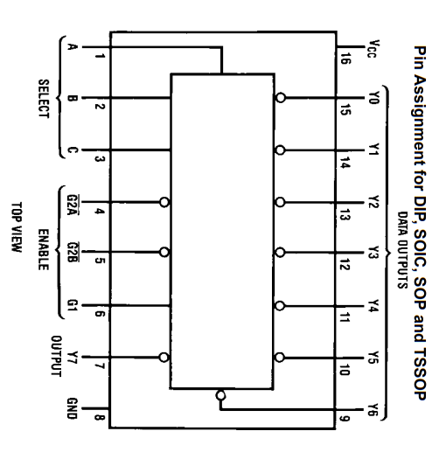
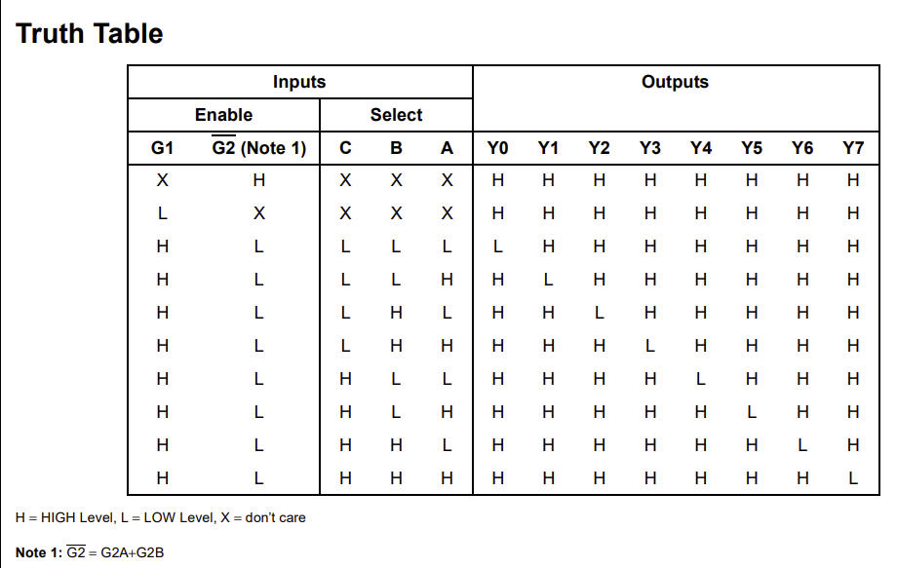
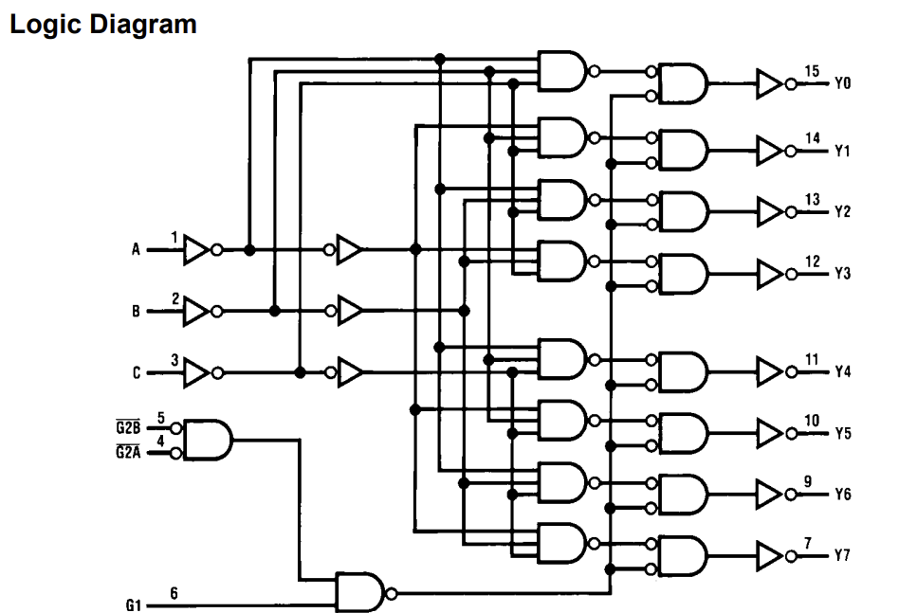
138 - 3-to-8 Line Decoder

Slide 84
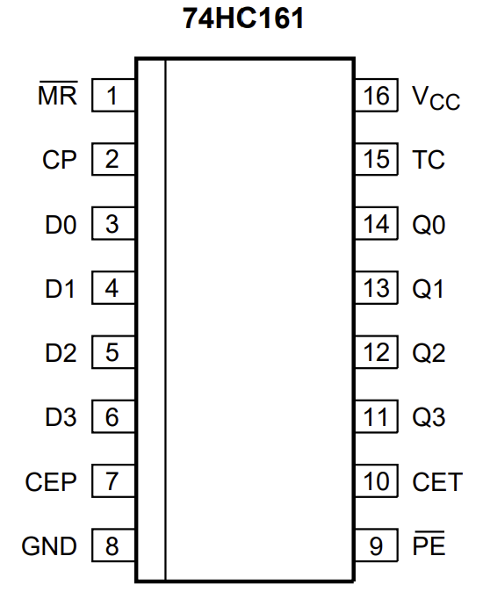
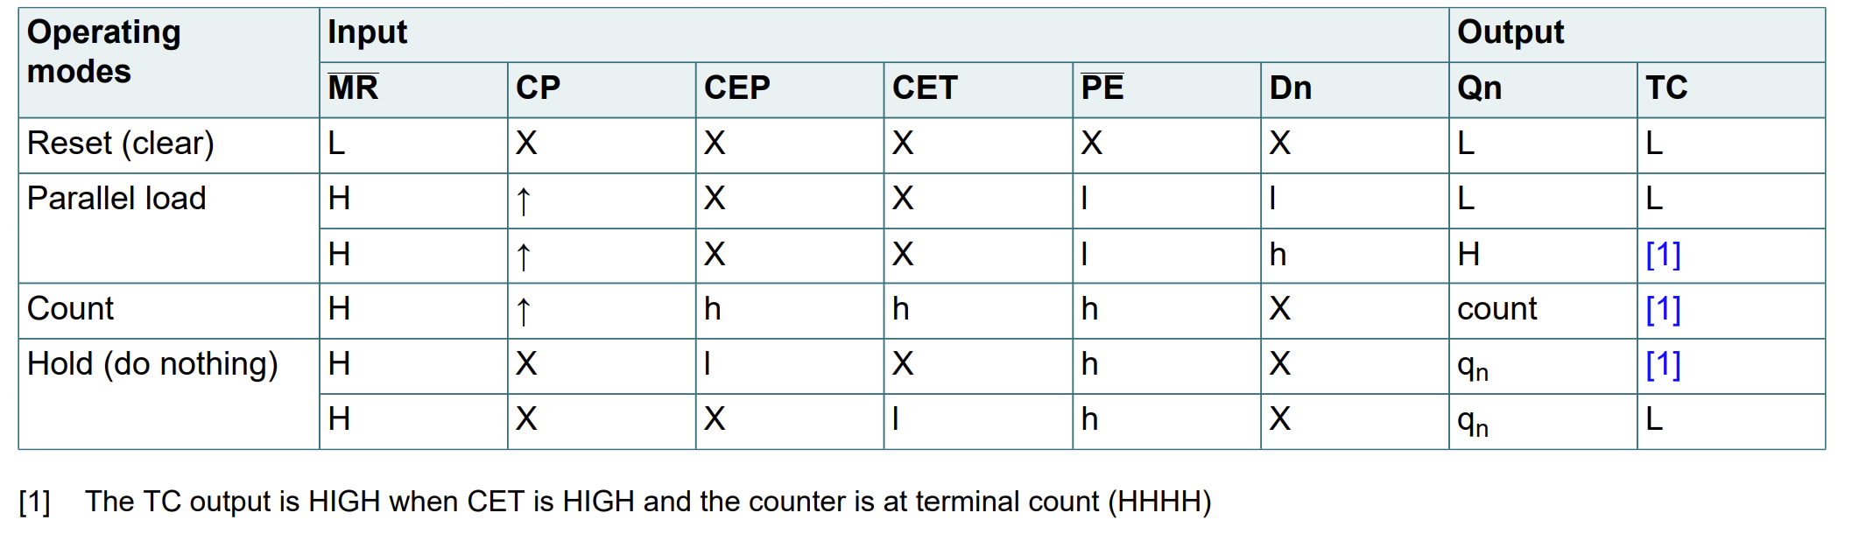
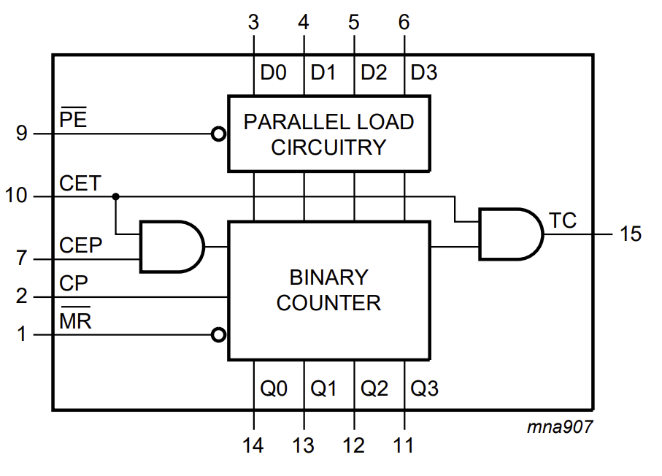
161 - 4-Bit Binary Counter, Asynchronous Reset
Notes:
Parallel Load need to happen on invese clock
Count need to happen on [TBD – need timing diagram of the PC Advance]

Slide 85
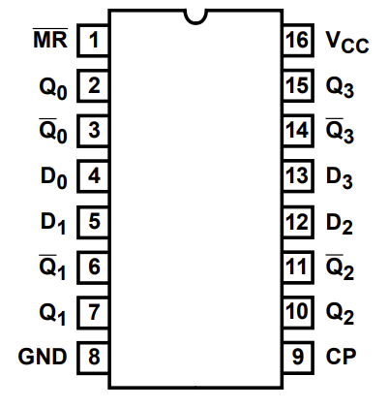
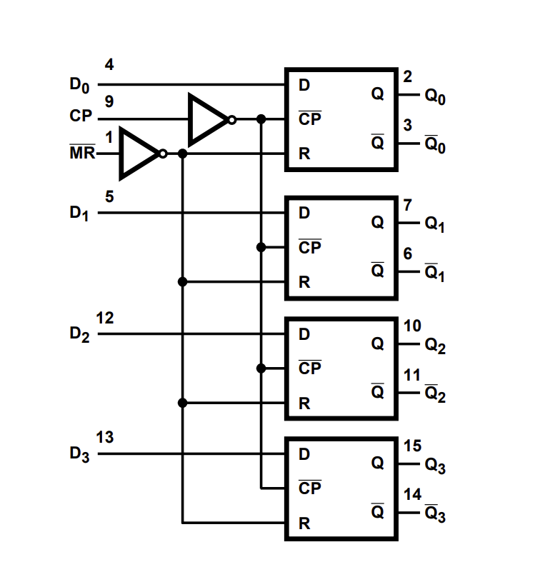
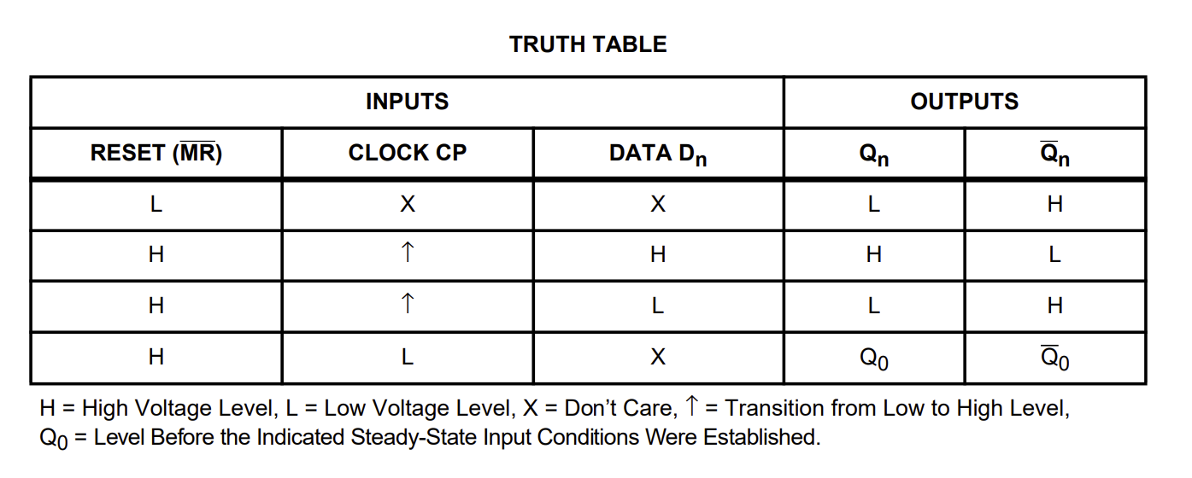
175 - Quad D-Type Flip-Flop with Reset

Slide 86
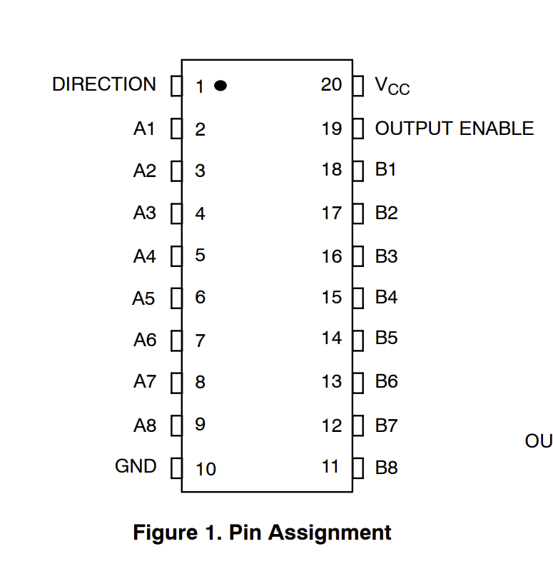
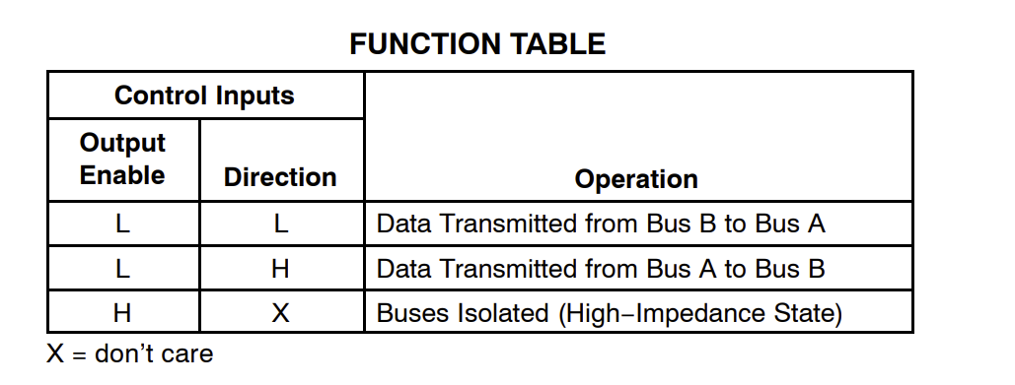
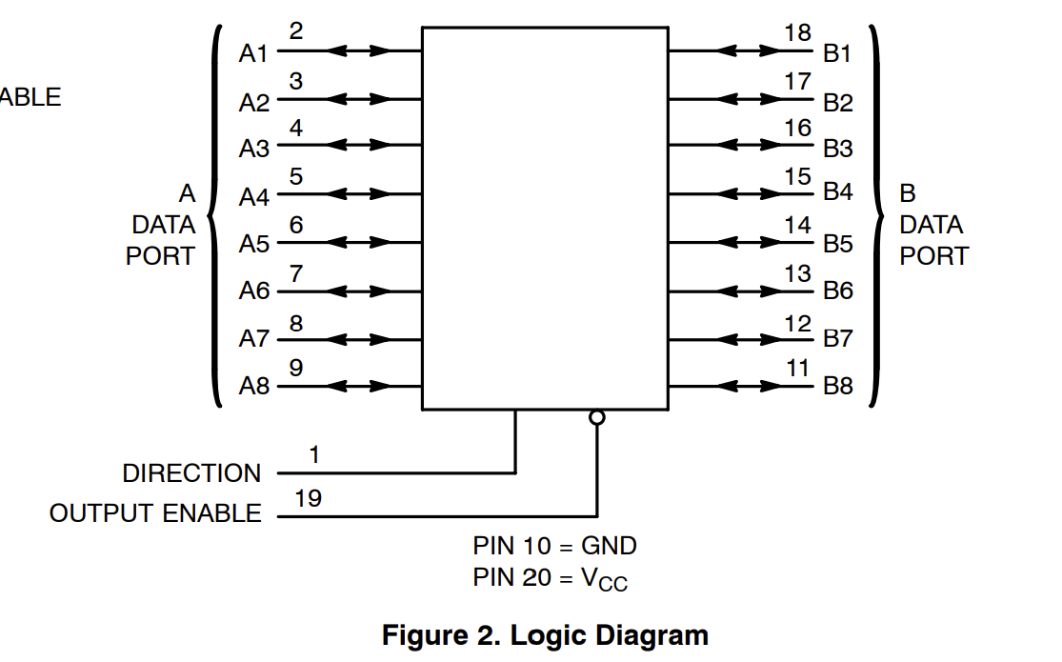
245 - Octal D-Type Flip-Flop with Reset

Slide 87
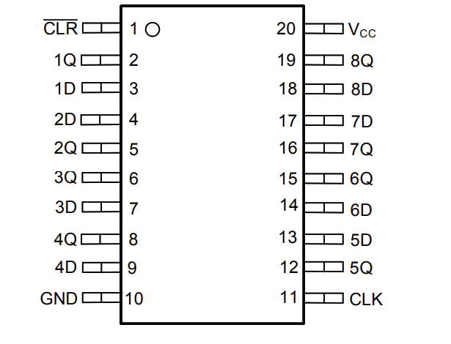
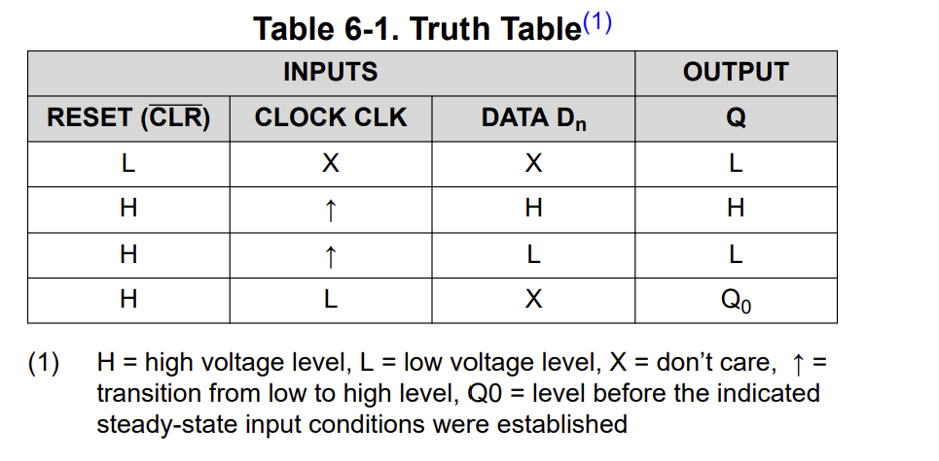
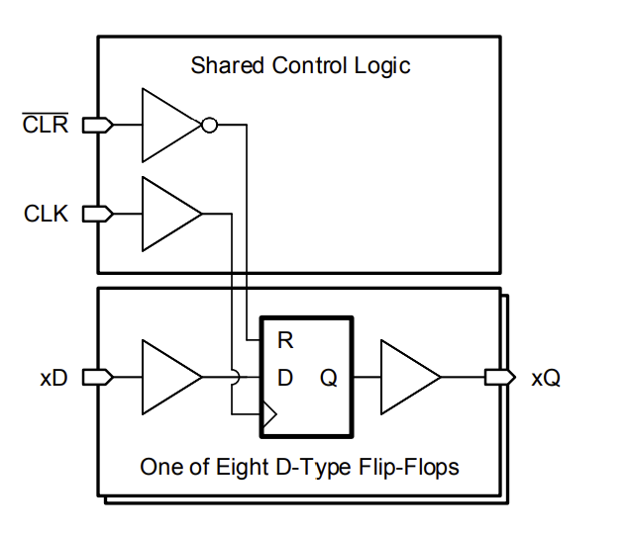
273 - Octal D-Type Flip-Flop with Reset

Slide 88
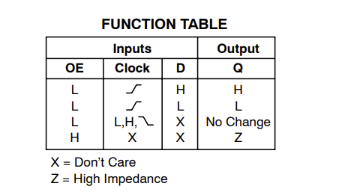
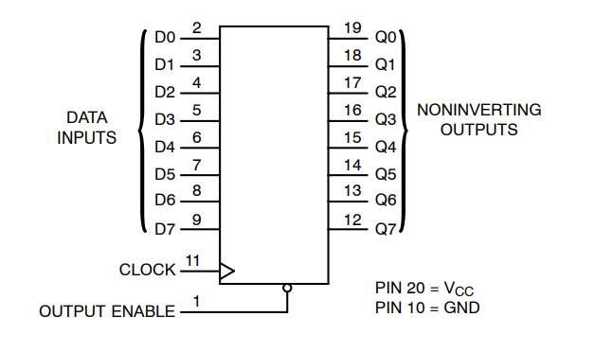
547 - Octal 3−State Noninverting D Flip−Flop

Slide 89
ByteFrost V1.0 – First Working Version

Slide 90
Fetch State Machine Example
Data
Micro Ins
(EEPROM)
Program
Counter
Micro Ins
Counter
Address Lo
PC Advance
Address Hi
Opcode
Address
Instruction Register
High
Instruction Register
Low
Program
(EEPROM)
Data
Fetch State Machine
90

Slide 91

Hardware
Debug Mode
Clock
Status And Control
SRAM
Control
Register File
Micro Intructions
Load PC
Branch
H Reg Out
Reg Out
Select
Program Counter
Load Flags
ADC
SBC
ALU MUX
PC Advance
XOR MUX
Relative Branch
Load A and B
Load Flags
SRAM
XOR
ADD SUB

Slide 92





Register File
Read from Register
~G Output Enable
A,B Register Id
Read from Register
~G Output Enable
A,B Register Id
Main CLK
R.O. Select Low
D1
Clock
R.O. Select High
D2
µC 4. Reg Out En
D3
D4
OE0
OE1
OE2
OE3
C2
C3
C0
C1
C1
C0
HC139
R0
R1
R2
R3
C2
C3
OE0
OE1
OE2
OE3
D5
Write to Register
~G: Input Clock Enable
A,B Register Id
D6
OpCode
[7:6] Rd RI
µC 5. Reg In En
D7
OpCode [7:6] Rd
D8
92

Slide 93


Registers Schematics
Read from Register
~G Output Enable
A,B Register Id
R.O. Select Low
R.O. Select High
µC 4. Reg Out En
OE3
OE2
OE1
OE0
C0
Write to Register
~G: Input Clock Enable
A,B Register Id
OpCode [7:6] Rd
C1
µC 5. Reg In En
C2
C3
Main CLK
Clock
93

Slide 94

Register Out (RO) Select
OpCode[6]: Rd Low
OpCode[12]: Rs1 Low
OpCode[14]: Rs2 Low
R.O. Select Low
µC 13: Reg Out Rd
OpCode
[7:6]
74HC153
Dual
4:1 MUX
OpCode
[15:12]
µC 3: Reg Out Select
R.O. Select High
OpCode[13]: Rs1 High
OpCode[15]: Rs2 High
OpCode[7]: Rd High
94

Slide 95




Clock
Parts | Min | Frequency
0.01uF (103) | 5KHz | 420KHz
R2=100
Rpin5=10K
100Ω
9.3kΩ
220
6
Running CLK
R on pin 5:
The design of using Vout as power for charging C1 generates 50% duty cycle only if Vout==Vcc. In reality, it is lower and the capacitor takes more time to reach the higher trigger point and duty cycle without it is only 33%.
With 10K on pin 5, both triggering points become lower, closer to 1/3 and 2/3 of Vout (instead of Vcc). That provides 50% duty cicle,also increase the frequency because the distance between the points is smaller (increasing the max frequency of this design from 250hHz to 420kHz)
10KΩ
2
0.1uF
Or
10uF
S.S. CLK
Single Step
(Yellow wire)
95

Slide 96





Clock Gating
S.S. CLK
Reset
BRK Button
(Purple)
74LS76
RUN LED
(Brown wire)
Running CLK
Clock LED
(Green wire)
Cont. Button
(Gray)
Halt LED
(Blue wire)
Main CLK
Clock gating 2sec for
Arduino (display) to boot
Op Code 1: BRK
Running CLK
Reset Button
(Red wire)
Main Reset
Reset
Reset LED
(Orange wire)
2s
96
4ms

Slide 97
Micro Instructions EEPROMs
µC 23:
µC 15: SP Count
µC 7: PC Advance
µC 22:
µC 14: SP Addr
µC 6: Out Reg H
µC 21:
µC 13: Reg Out Rd
µC 5. Reg In En
µC 5. Reg In En
µC 20:
µC 12: Ld Data Addr
µC 4: Reg Out En
µC 4. Reg Out En
µC 19:
µC 11: RAM Store
µC 3: Reg Out Select
µC 18:
µC 10: RAM Load
µC 2: ALU Out En
µC 2. ALU Out En
µC 17:
µC 9: PC Out
µC 1: ALU Load A
µC 16: SP Up/Down
µC 8: PC Load
µC 0: ALU Load B
1,0,0,0,0,0,0,0
1,0,0,0,0,0,0,0
1,0,0,0,0,0,0,0
Micro Ins 16_23
Micro Ins 8_15
Micro Ins 0_7
0,0
0,0
0,0
3 bit
3 bit
3 bit
5 bit
5 bit
5 bit
3 bit
Counter A2..A0
Opcode A7..A3
OpCode
[4:0]
# Reset_microPC
161
Main CLK
97

Slide 98
Program Counter
Main CLK
Data Bus
Main Reset
Addr
[7:0]
74HC245
74HC161 [7:4]
74HC161 [3:0]
Addr
[7:0]
Addr
[7:4]
Addr
[3:0]
Load PC
Program Address Bus
Addr
[8:1]
INC Prog Counter
µC 9: PC Out
Prog Counter Addr[0]
Prog EEPROM
Prog
Data[7:0]
98

Slide 99
Fetch State Machine
Prog
Data[7:0]
273 Lo
175
OpCode
[4:0]
OpCode
[7:5] Flags
OpCode
[7:6] Rd RO
OpCode [5] A/I
Prog
Data[7:0]
OpCode
[7:6] Rd RI
273 Hi
µC 7: PC Advance
Main CLK
MR
H Reg
8 bits
OpCode
[15:12]
Reset_microPC Active Low
Main Reset
INC Prog Counter
Decimal
Dot LED
Prog Counter lsb
99

Slide 100
Fetch State Machine
Prog
Data[7:0]
273 Lo
175
OpCode
[4:0]
OpCode
[7:5] Flags
OpCode
[7:6] Rd RO
OpCode [5] A/I
1
Prog
Data[7:0]
OpCode
[7:6] Rd RI
0
273 Hi
1
µC 7: PC Advance
1
Main CLK
MR
H Reg
8 bits
OpCode
[15:12]
Reset_microPC Active Low
Main Reset
INC Prog Counter
Decimal
Dot LED
Prog Counter lsb
100

Slide 101
OpCode Decoder
Op Code 1: BRK
OpCode_08
OpCode_6
OpCode_0D
OpCode_7
BRANCH Relative
74HC138
OpCodes 16-23
74HC138
OpCodes 8-15
74HC138
OpCodes 0-7
‘0’
‘0’
‘1’
0
1
2
3
4
OpCode
[4:0]
101

Slide 102
Output H Register to Data Bus
Data
Bus
H Reg
8 bits
HC245
H → Bus
µC 6: Out Reg H
OpCode_6
H Reg[7:4]
HC245
H4 → Bus
4b0
If opcode is 00110 then zero-extended 4-bit immediate from high instruction register
is written to the bus; otherwise, the full 8-bit high instruction register is written to
bus as an 8-bit immediate
102

Slide 103
ALU Interface – Flags, A,B Registers, Op Code selection
Clock
MR
ALU
Clk
µC 1: ALU Load A
A_I
A
Clk
µC 0: ALU Load B
74HC161
Data
Bus
74HC161
OpCode_7
BRANCH Relative
Gray
4b’0110 (ADD)
0
74HC161
ALU OpCode
B
74HC157
74HC161
4b from H reg[3:0]
1
µC 2. ALU Out En
Data Bus
74HC251
C
Don’t update flags on BR relative
Parallel Load Enable
Flags
74HC161
Flags
Notes: Registers A and B are implemented by two HC161s, each stores 4 bits as the typical HC273 and HC347 won't fit into the 16pin sockets on the ALU wireup board.
The branch relative instruction doesn’t update flag bits to avoid corrupting the flag register state when executing a branch instruction (which may occur due to the ADD operation performed)
Carry In

Slide 104
Branch
OpCode
[7:5]
Instruction LSB
Q7 Q6 Q5
µC 8: PC Load
D4
D5
D6
D7
‘1’
‘N’
Load PC
‘C’
74HC161
Flags
74HC151
‘Z’
C2 | C1 | C0 | Condition | Instruction LSB | Equivalent Assembly Instruction
0 | 0 | 0 | JMP | 05 | JMP
0 | 0 | 1 | N | 25 | BMI – Branch on Minus
0 | 1 | 0 | C | 45 | BCS – Branch Carry Set
0 | 1 | 1 | Z | 65 | BEQ – Branch Equal
1 | 0 | 0 | Never | 85 | NOP
1 | 0 | 1 | !N | A5 | BPL – Branch on Plus
1 | 1 | 0 | !C | C5 | BCC – Branch Carry Clear
1 | 1 | 1 | !Z | E5 | BNE

Slide 105


ALU OpCodes 2,3,7
Op Select | Special Func. = 0 |  | Special Func. = 1 |  | Flag in
010 - 2 | A XOR B | XOR: 4 | !B | NOT: 5 | -
011 - 3 | A + B | ADD: 6 | A – B | SUB: 7 | -
111- 7 | A + B + Cin | ADC: E | A – B + Cin | SBC: F | Cin
ALU opcode(010), SF(0 / 1) – A XOR B / !B
No change to the source SF for ADD/SUB/ADC/SBC/!B
SF
{Op =XX0, SF = 0} → A XOR B; Else B or !B
ALU_Op[0]
B
Adder
ADD/SUB/ADC/SBC/!B
A
Op Codes
‘011’ , ‘111’
SF
0
8
x8
x8
B or !B
A
1
8
!B or (A XOR B)
Op Code ‘010’ output
Carry-in to Adder
105

Slide 106
ALU: ADD Carry/SUB Carry
Note the difference between the ALU function opcodes for ADD / SUB and ADC / SBC:
ALU opcode(011), SF(0 / 1) – ADD/SUB
ALU opcode(111), SF(0 / 1) – ADC/SBC
Note: The 6502 ISA only supports ADC/SBC (along with Set Carry and Reset Carry)
ALU_Op[2]
SF
ADD/SUB
0
157
Carry-in to Adder
ADC/SBC
1
Carry-in from last Op (from carry bit in flags register)
106

Slide 107
SRAM (v1.0)
Data
Bus
µC 10: RAM Load
Main CLK
Clock
µC 11: RAM Store
µC 12: Ld Data Addr
Clk
374 Addr
!Clk
Control
I/O[0:7]
SRAM
AND
3state
µC 14: SP Addr
3state
Change MSB
Load 0
169: Up Down Counter
245: 3-state
MR
Q[1:8] → A[0:7]
µC 15: SP Count
Count
107
µC 16: SP Up/Down
Up/Down

Slide 108





Display
Disp Char
5 4 3 2 1 0
6 7
MR
INT0
OpCode [5] A/I
Display Load

Slide 109
Display Load
Data Bus
273 Char
Disp Char
µC 6: Out Reg H
µC 3: Reg Out Select
Display Load
OpCode_08
OpCode_0D
Main CLK

Slide 110
Op Code & Micro Instruction
110
110

Slide 111
Assembler Syntax
An assembly file is composed of lines with the following form:
[INSTR] [PARAM 1] [, PARAM 2] [, PARAM 3] // Comment
Misc. Instruction | Meaning | Format
NOP | No operation | NOP
BRK | Stop | BRK
OUT | Print 8-bit value to output | OUT Rs, #imm
ALU Instruction | Meaning | Format
OR | Bitwise OR | OR Rd, Rs1, Rs2
AND | Bitwise AND | AND Rd, Rs1, Rs2
XOR | Bitwise XOR | XOR Rd, Rs1, Rs2
NOT | Bitwise NOT | NOT Rd, Rs1
ADD | Addition | ADD Rd, Rs1, Rs2
SUB | 2’s Complement subtraction | SUB Rd1, Rs1, Rs2 (Rd1 = Rs1 – Rs2)
LSL | Bitwise logical shift left by 1 bit | LSL Rd, Rs1
ASR | Arithmetic shift right by 1 bit | ASR Rd, Rs1
ADC | Add with carry | ADC Rd, Rs1, Rs2
SUC | Subtract with borrow (using carry flag) | SUC Rd, Rs1, Rs2 (Rd1 = Rs1 – Rs2)
Branch Instruction | Meaning | Format
JMP | Unconditional branch | A + I: JMP #imm A + R: R + I: R + R:
BIN | Branch If Negative | A + I: BIN #imm
BIC | Branch if Carry | A + I: BIC #imm
BIZ | Branch if Zero | A + I: BIZ #imm
BNN | Branch if not Negative | A + I: BNN #imm
BNC | Branch if not Carry | A + I: BNC #imm
BNZ | Branch if not Zero | A + I: BNZ #imm
Register Instruction | Meaning | Format
LDR | Load register with 8-bit immediate | LDR Rd, #imm
MOV | Copy register value to another register | MOV Rd, Rs
111

Slide 112
Instruction set families
0 15
Type | 0 1 2 3 4 | 5 | 6 7 | 8 9 10 11 | 12 13 | 14 15
ALU | OpCode | X | Rd | Function | Rs1 | Rs2
Type | 0 1 2 3 4 | 5 | 6 7 | 8 9 10 11 | 12 13 | 14 15
Load Imm | OpCode | X | Rd | Immediate (8-bit) | Rs1 | Rs2
Type | 0 1 2 3 4 | 5 | 6 7 | 8 9 10 11 | 12 13 | 14 15
Load Reg | OpCode | X | Rd | XXXX | Rs1 | XX
112

Slide 113
Instruction set
Phase 0 | NOP, BRK
Phase 1 | Fib, Mult
Phase 2 | Self Test
Phase 3 | Display, 8 Queen
Completed
Op code | Instruction | Details
0000 | NOP | No operation
0001 | BRK | Break
0010 | ALU (Format ALU Rd, Rs1, Rs2) | ALU instruction
0011 | LDR | Load Register (immediate, other register) ?
0100 | MOV | Copy Register (MOV instruction in ARM)
0101 | Branch Absolute | Jump to an address (8bit)
0110 | ALU Immediate (Format: ALU Rd, Rd, imm) | ALU instruction with value from immediate
0111 | BRANCH Relative | Relative Branch (+127 to -128)
1000 | OUT reg | Send a register as a character or integer to the display
1001 | LMA | Load register from address
1010 | SMA | Store register to address
1011 | LMR | Load register from address in another register
1100 | SMR | Store register into an address in another register
1101 | GSB | Jump, store current PC in stack
1110 | RTN | Load PC from stack
1111 | OUT Immediate | Send Reg H as a character or integer to display
113

Slide 114
Micro-Instructions Control: NOP Instruction (00000)
0
Bit | Operation
16 | Stack Pointer Increment / Decrement (0: decrease / 1: increase)
15 | Stack Pointer Count
14 | RAM Address Select (0: Address register / 1: Stack pointer)
13 | Use Rd as Source
12 | Lower Address Register Load
11 | Mem Write
10 | Mem Read
9 | PC Out
8 | PC Load
7 | PC advance
6 | Program Register H Write to Bus (parameter)
5 | Register File Input Enable
4 | Register File Output Enable
3 | Register File Output Select (parameter – 0 -> Rs1, 1 -> Rs2)
2 | ALU output enable
1 | ALU load register A
0 | ALU load register B
Cycle # | Instruction | Explanation
0 | 00000000 = 0x00
1 | 10000000 = 0x80 | Increment PC
2
3
4
5
6
7
NOP
114

Slide 115
Micro-Instructions Control: BREAK (00001)
1
Bit | Operation
16 | Stack Pointer Increment / Decrement (0: decrease / 1: increase)
15 | Stack Pointer Count
14 | RAM Address Select (0: Address register / 1: Stack pointer)
13 | Use Rd as Source
12 | Lower Address Register Load
11 | Mem Write
10 | Mem Read
9 | PC Out
8 | PC Load
7 | PC advance
6 | Program Register H Write to Bus (parameter)
5 | Register File Input Enable
4 | Register File Output Enable
3 | Register File Output Select (parameter – 0 -> Rs1, 1 -> Rs2)
2 | ALU output enable
1 | ALU load register A
0 | ALU load register B
Cycle # | Instruction | Explanation
0 | 00000000 = 0x00 | Do nothing
1 | 10000000 = 0x80 | Increment PC
2
3
4
5
6
7
Note: BRK has the same microcode as NOP, but the opcode decoder halts the clock when the opcode 00001 is detected. Stepping through it manually (via Single-Step / Run button press) resumes the clock. Hence, BRK acts as a hardware breakpoint.
BRK
115

Slide 116
ALU with changes
Op Select | Special Func. = 0 |  | Special Func. = 1 |  | Flag in | Flags Out
0 | A OR B | OR: 0 | A OR B |  | - | Z, N
1 | A AND B | AND: 2 | A AND B |  | -
2 | A XOR B | XOR: 4 | ~B | NOT: 5 | - | Z, N
3 | A + B | ADD: 6 | A – B | SUB: 7 | - | Z, N, Co
4 | Shift Left A A[0]=0 | ASL: 8 | Rotate left A A[0]=Cin | ROL: 9 | Cin (Rotate) | Z, N=A[6], Co=A[7]
5 | Shift Right A | LSR: A | Arithmetic S.R. A | ASR: B | - | Z, N, Co=A[0]
6 | Rotate Right | ROR: C | Cin -> A-> Cout |  | Cin | Z, N, Co=A[0]
7 | A + B + Cin | ADC: E | A – B + Cin | SBC: F | Cin | Z, N, Co
Proposal | # of IC slots | Description | Op Code
OR and ADD share Op Code (low priority) | 2x 74LS157 | Special Function select OR or AND | Release op code
Move A, B Regs (require replacement of 74LS251 with 74HC251) | 4x 74LS161 1x 74LS00 NAND | Reduce interface to one data bus instead of A, B, C (NAND for clock gate/invert) | No change
Proposals for the additional operations
How to chain Shift Right of two bytes?
116

Slide 117
Micro-Instructions Control: ALU (00010)
2
Bit | Operation
16 | Stack Pointer Increment / Decrement (0: decrease / 1: increase)
15 | Stack Pointer Count
14 | RAM Address Select (0: Address register / 1: Stack pointer)
13 | Use Rd as Source
12 | Lower Address Register Load
11 | Mem Write
10 | Mem Read
9 | PC Out
8 | PC Load
7 | PC advance
6 | Program Register H Write to Bus (parameter)
5 | Register File Input Enable
4 | Register File Output Enable
3 | Register File Output Select (parameter – 0 -> Rs1, 1 -> Rs2)
2 | ALU output enable
1 | ALU load register A
0 | ALU load register B
Cycle # | Instruction | Explanation
0 | 00010010 = 0x12 | Load Rs1 to reg A
1 | 00011001 = 0x19 | Load Rs2 to reg B
2 | 00100100 = 0x24 | Output and Read to Rd
3 | 10000000 = 0x80 | Increment PC
4
5
6
7
ADD Rd, Rs1, Rs2
Type | 15 14 13 12 | 11 10 | 9 8 | 7 6 5 4 | 3 2 | 1 0
ALU | OpCode | XX | Rd | Function | Rs1 | Rs2
Type | 15 14 | 13 12 | 11 10 9 8 | 7 6 | 5 4 | 3 2 1 0
ALU | Rs2 | Rs1 | S2 S1 S0 SF (Function sel) | Rd | XX | OpCode
117

Slide 118
Micro-Instructions Control: Load Immediate to Reg (00011)
3
Bit | Operation
16 | Stack Pointer Increment / Decrement (0: decrease / 1: increase)
15 | Stack Pointer Count
14 | RAM Address Select (0: Address register / 1: Stack pointer)
13 | Use Rd as Source
12 | Lower Address Register Load
11 | Mem Write
10 | Mem Read
9 | PC Out
8 | PC Load
7 | PC advance
6 | Program Register H Write to Bus (parameter)
5 | Register File Input Enable
4 | Register File Output Enable
3 | Register File Output Select (parameter – 0 -> Rs1, 1 -> Rs2)
2 | ALU output enable
1 | ALU load register A
0 | ALU load register B
Cycle # | Instruction | Explanation
0 | 01100000 = 0x60 | Write imm to bus and Rd read
1 | 10000000 = 0x80 | Increment PC
2
3
4
5
6
7
LDR Rd, #0x00
Type | 15 14 13 12 | 11 10 | 9 8 | 7 6 5 4 | 3 2 | 1 0
Load Imm | OpCode | XX | Rd | Immediate (8-bit) | Rs1 | Rs2
Type | 15 14 | 13 12 | 11 10 9 8 | 7 6 | 5 | 4 3 2 1 0
Load Imm | Immediate (8-bit) |  | Immediate (8-bit) | Rd | X | OpCode
118

Slide 119
Micro-Instructions Control: MOV (00100)
4
Bit | Operation
16 | Stack Pointer Increment / Decrement (0: decrease / 1: increase)
15 | Stack Pointer Count
14 | RAM Address Select (0: Address register / 1: Stack pointer)
13 | Use Rd as Source
12 | Lower Address Register Load
11 | Mem Write
10 | Mem Read
9 | PC Out
8 | PC Load
7 | PC advance
6 | Program Register H Write to Bus (parameter)
5 | Register File Input Enable
4 | Register File Output Enable
3 | Register File Output Select (parameter – 0 -> Rs1, 1 -> Rs2)
2 | ALU output enable
1 | ALU load register A
0 | ALU load register B
Cycle # | Instruction | Explanation
0 | 00110000 = 0x30 | Write Rs1 to bus and Rd reads
1 | 10000000 = 0x80 | Increment PC
2
3
4
5
6
7
MOV Rd, Rs1
Type | 15 14 13 12 | 11 10 | 9 8 | 7 6 5 4 | 3 2 | 1 0
Load Reg | OpCode | XX | Rd | XXXX | Rs1 | XX
Type | 15 14 | 13 12 | 11 10 9 8 | 7 6 | 5 | 4 3 2 1 0
Load Reg | XX | Rs1 | XXXX | Rd | X | OpCode
119

Slide 120
Micro-Instructions Control: Branch / Jump Absolute Immediate (00101)
5
Bit | Operation
16 | Stack Pointer Increment / Decrement (0: decrease / 1: increase)
15 | Stack Pointer Count
14 | RAM Address Select (0: Address register / 1: Stack pointer)
13 | Use Rd as Source
12 | Lower Address Register Load
11 | Mem Write
10 | Mem Read
9 | PC Out
8 | PC Load
7 | PC advance
6 | Program Register H Write to Bus (parameter)
5 | Register File Input Enable
4 | Register File Output Enable
3 | Register File Output Select (parameter – 0 -> Rs1, 1 -> Rs2)
2 | ALU output enable
1 | ALU load register A
0 | ALU load register B
Cycle # | Instruction | Explanation
0 | 0x1_40 01_0100_0000 | Write H register to bus and PC (conditionally) reads
1 | 0x0_80 00_1000_0000 | PC advance
2
3
4
5
6
7
C2 | C1 | C0 | Condition | Low instruction register | Assembly
0 | 0 | 0 | JMP | 05 | JMP
0 | 0 | 1 | N | 25 | BMI – Branch on Minus
0 | 1 | 0 | C | 45 | BCS – Branch Carry Set
0 | 1 | 1 | Z | 65 | BEQ – Branch Equal
1 | 0 | 0 | Never | 85 | NOP
1 | 0 | 1 | !N | A5 | BPL – Branch on Plus
1 | 1 | 0 | !C | C5 | BCC – Branch Carry Clear
1 | 1 | 1 | !Z | E5 | BNE
Type | 15 14 | 13 12 | 11 10 9 8 | 7 6 5 | 4 3 2 1 0
Branch | Immediate (8-bit) |  | Immediate (8-bit) | C2 C1 C0 | OpCode
120

Slide 121
Micro-Instructions Control: ALU immediate (4-bit) (00110)
6
Bit | Operation
16 | Stack Pointer Increment / Decrement (0: decrease / 1: increase)
15 | Stack Pointer Count
14 | RAM Address Select (0: Address register / 1: Stack pointer)
13 | Use Rd as Source
12 | Lower Address Register Load
11 | Mem Write
10 | Mem Read
9 | PC Out
8 | PC Load
7 | PC advance
6 | Program Register H Write to Bus (parameter)
5 | Register File Input Enable
4 | Register File Output Enable
3 | Register File Output Select (parameter – 0 -> Rs1, 1 -> Rs2)
2 | ALU output enable
1 | ALU load register A
0 | ALU load register B
Cycle # | Instruction | Explanation
0 | 10_0000_0001_0010 = 2012 | Load Rd to reg A
1 | 0100_0001 = 0x0041 | Load 4 bit imm to reg B
2 | 0010_0100 = 0x0024 | Write ALU output to Rd
3 | 1000_0000 = 0x0080 | Increment PC
4
5
6
7
ADD Rd, #0x00
Type | 15 14 13 12 | 11 10 | 9 8 | 7 6 5 4 | 3 2 | 1 0
ALU | OpCode | XX | Rd | Function | Rs1 | Rs2
Type | 15 14 13 12 | 11 10 9 8 | 7 6 | 5 | 4 3 2 1 0
ALU | 4-bit imm. | S2 S1 S0 SF (Function sel) | Rd | X | OpCode
121

Slide 122
Micro-Instructions Control: Branch / Jump Relative Immediate (00111)
7
Bit | Operation
16 | Stack Pointer Increment / Decrement (0: decrease / 1: increase)
15 | Stack Pointer Count
14 | RAM Address Select (0: Address register / 1: Stack pointer)
13 | Use Rd as Source
12 | Lower Address Register Load
11 | Mem Write
10 | Mem Read
9 | PC Out
8 | PC Load
7 | PC advance
6 | Program Register H Write to Bus (parameter)
5 | Register File Input Enable
4 | Register File Output Enable
3 | Register File Output Select (parameter – 0 -> Rs1, 1 -> Rs2)
2 | ALU output enable
1 | ALU load register A
0 | ALU load register B
Cycle # | Instruction | Explanation
0 | 10_0000_0010 0x2_02 | Load PC into reg A
1 | 00_0100_0001 0x0_41 | Load immediate into reg B
2 | 01_0000_0100 0x1_04 | Output ALU val, load PC
3 | 00_1000_0000 0x0_80 | Advance PC
4
5
6
7
C2 | C1 | C0 | Condition | OpCode | Assembly
0 | 0 | 0 | JMP | 07 | JMP
0 | 0 | 1 | N | 27 | BMI – Branch on Minus
0 | 1 | 0 | C | 47 | BCS – Branch Carry Set
0 | 1 | 1 | Z | 67 | BEQ – Branch Equal
1 | 0 | 0 | Never | 87 | NOP
1 | 0 | 1 | !N | A7 | BPL – Branch on Plus
1 | 1 | 0 | !C | C7 | BCC – Branch Carry Clear
1 | 1 | 1 | !Z | E7 | BNE
Type | 15 14 | 13 12 | 11 10 9 8 | 7 6 5 | 4 3 2 1 0
Branch | Immediate (8-bit) |  | Immediate (8-bit) | C2 C1 C0 | OpCode
122

Slide 123
Micro-Instructions Control: OUT (01000) (Display ASCII or Integer)
8
Bit | Operation
16 | Stack Pointer Increment / Decrement (0: decrease / 1: increase)
15 | Stack Pointer Count
14 | RAM Address Select (0: Address register / 1: Stack pointer)
13 | Use Rd as Source
12 | Lower Address Register Load
11 | Mem Write
10 | Mem Read
9 | PC Out
8 | PC Load
7 | PC advance
6 | Program Register H Write to Bus (parameter)
5 | Register File Input Enable
4 | Register File Output Enable
3 | Register File Output Select (parameter – 0 -> Rs1, 1 -> Rs2)
2 | ALU output enable
1 | ALU load register A
0 | ALU load register B
Cycle # | Instruction | Explanation
0 | 0000_0000 = 0x00 | Wait for H register to be loaded (need value of Rs1)
1 | 0001_0000 = 0x10 | Write Rs1 to the bus (when opcode 01000 is detected, the value on the bus is read by the OUT register to the display)
2 | 1000_0000 = 0x80 | Advance PC
3
4
OUT Rs1, A
Type | 15 14 13 12 | 11 10 | 9 8 | 7 6 5 4 | 3 2 | 1 0
Load Reg | OpCode | XX | Rd | XXXX | Rs1 | XX
Type | 15 14 | 13 12 | 11 10 9 8 | 7 6 | 5 | 4 3 2 1 0
Out | XX | Rs1 | XXXX | XX | I=1 A=0 | OpCode
Type | 15 14 | 13 12 | 11 10 9 8 | 7 6 | 5 | 4 | 3 2 1 0
Out | XX | Rs1 | XXXX | XX | I=1 A=0 | X | OpCode
123

Slide 124
Micro-Instructions Control: LMA (Load Memory Absolute) (01001)
9
Bit | Operation
16 | Stack Pointer Increment / Decrement (0: decrease / 1: increase)
15 | Stack Pointer Count
14 | RAM Address Select (0: Address register / 1: Stack pointer)
13 | Use Rd as Source
12 | Lower Address Register Load
11 | Mem Write
10 | Mem Read
9 | PC Out
8 | PC Load
7 | PC advance
6 | Program Register H Write to Bus (parameter)
5 | Register File Input Enable
4 | Register File Output Enable
3 | Register File Output Select (parameter – 0 -> Rs1, 1 -> Rs2)
2 | ALU output enable
1 | ALU load register A
0 | ALU load register B
Cycle # | Instruction | Explanation
0 | 1_0000_0100_0000 = 1040 | Load 8-bit address to address register
1 | 0_0100_0010_0000 = 0420 | Read byte from RAM and store in Rd
2 | 0_0000_1000_0000 = 0080 | Increment PC
3
4
5
6
7
LMA Rd, #Addr
Type | 15 14 13 12 11 10 9 8 | 7 6 | 5 | 4 3 2 1 0
Load Reg | 8-bit (LSBs) Address | Rd | X | OpCode
124

Slide 125
Micro-Instructions Control: SMA (Store Memory Absolute) (01010)
A
Bit | Operation
16 | Stack Pointer Increment / Decrement (0: decrease / 1: increase)
15 | Stack Pointer Count
14 | RAM Address Select (0: Address register / 1: Stack pointer)
13 | Use Rd as Source
12 | Lower Address Register Load
11 | Mem Write
10 | Mem Read
9 | PC Out
8 | PC Load
7 | PC advance
6 | Program Register H Write to Bus (parameter)
5 | Register File Input Enable
4 | Register File Output Enable
3 | Register File Output Select (parameter – 0 -> Rs1, 1 -> Rs2)
2 | ALU output enable
1 | ALU load register A
0 | ALU load register B
Cycle # | Instruction | Explanation
0 | 01_0000_0100_0000 = 1040 | Load 8-bit address to address register
1 | 10_1000_0001_0000 = 2810 | Store byte to RAM from Rd
2 | 00_0000_1000_0000 = 0080 | Increment PC
3
4
5
6
7
SMA Rd, #Addr
Type | 15 14 13 12 11 10 9 8 | 7 6 | 5 | 4 3 2 1 0
Load Reg | 8-bit (LSBs) Address | Rd | X | OpCode
125

Slide 126
Micro-Instructions Control: LMR (Load Memory Register) (01011)
B
Bit | Operation
16 | Stack Pointer Increment / Decrement (0: decrease / 1: increase)
15 | Stack Pointer Count
14 | RAM Address Select (0: Address register / 1: Stack pointer)
13 | Use Rd as Source
12 | Lower Address Register Load
11 | Mem Write
10 | Mem Read
9 | PC Out
8 | PC Load
7 | PC advance
6 | Program Register H Write to Bus (parameter)
5 | Register File Input Enable
4 | Register File Output Enable
3 | Register File Output Select (parameter – 0 -> Rs1, 1 -> Rs2)
2 | ALU output enable
1 | ALU load register A
0 | ALU load register B
Cycle # | Instruction | Explanation
0 | 1_0000_0001_0000 = 1010 | Load Rs1 to Address Register
1 | 0_0100_0010_0000 = 0420 | Load value at the address into Rd
2 | 0_0000_1000_0000 = 0080 | Increment PC
3
4
5
6
7
LMR Rd, Rs
Effect: Rd = *Rs
Type | 15 14 | 13 12 | 11 10 9 8 | 7 6 | 5 | 4 3 2 1 0
Load Reg | XX | Rs1 | XXXX | Rd | X | OpCode
126

Slide 127
Micro-Instructions Control: SMR (Store Memory Register) (01100)
C
Bit | Operation
16 | Stack Pointer Increment / Decrement (0: decrease / 1: increase)
15 | Stack Pointer Count
14 | RAM Address Select (0: Address register / 1: Stack pointer)
13 | Use Rd as Source
12 | Lower Address Register Load
11 | Mem Write
10 | Mem Read
9 | PC Out
8 | PC Load
7 | PC advance
6 | Program Register H Write to Bus (parameter)
5 | Register File Input Enable
4 | Register File Output Enable
3 | Register File Output Select (parameter – 0 -> Rs1, 1 -> Rs2)
2 | ALU output enable
1 | ALU load register A
0 | ALU load register B
Cycle # | Instruction | Explanation
0 | 01_0000_0001_0000 = 1010 | Load Rs1 to Address Register
1 | 10_1000_0001_0000 = 2810 | Store value at Rd to RAM
2 | 00_0000_1000_0000 = 0080 | Increment PC
3
4
5
6
7
SMR Rd_data, Rs1_addr
Type | 15 14 | 13 12 | 11 10 9 8 | 7 6 | 5 | 4 3 2 1 0
Load Reg | XX | Rs1 | XXXX | Rd | X | OpCode
127

Slide 128
Micro-Instructions Control: OUT immediate (01101)
D
Bit | Operation
16 | Stack Pointer Increment / Decrement (0: decrease / 1: increase)
15 | Stack Pointer Count
14 | RAM Address Select (0: Address register / 1: Stack pointer)
13 | Use Rd as Source
12 | Lower Address Register Load
11 | Mem Write
10 | Mem Read
9 | PC Out
8 | PC Load
7 | PC advance
6 | Program Register H Write to Bus (parameter)
5 | Register File Input Enable
4 | Register File Output Enable
3 | Register File Output Select (parameter – 0 -> Rs1, 1 -> Rs2)
2 | ALU output enable
1 | ALU load register A
0 | ALU load register B
Cycle # | Instruction | Explanation
0 | 0000_0000 = 0x00 | Wait for H instruction register to be loaded
1 | 0100_0000 = 0x40 | Write program register H to the bus
2 | 1000_0000 = 0x80 | Advance PC
3
4
OUT Rs1, A
Type | 15 14 13 12 | 11 10 | 9 8 | 7 6 5 4 | 3 2 | 1 0
Load Reg | OpCode | XX | Rd | XXXX | Rs1 | XX
Type | 15 14 | 13 12 | 11 10 9 8 | 7 6 | 5 | 4 | 3 2 1 0
Out | 8-bit immediate |  | XXXX | XX | I=1 A=0 | X | OpCode
Type | 15 14 | 13 12 | 11 10 9 8 | 7 6 | 5 | 4 3 2 1 0
Out | 8-bit immediate |  | XXXX | XX | I=1 A=0 | OpCode
128

Slide 129
Micro-Instructions Control: PUSH (01110)
E
Bit | Operation
16 | Stack Pointer Increment / Decrement (0: decrease / 1: increase)
15 | Stack Pointer Count
14 | RAM Address Select (0: Address register / 1: Stack pointer)
13 | Use Rd as Source
12 | Lower Address Register Load
11 | Mem Write
10 | Mem Read
9 | PC Out
8 | PC Load
7 | PC advance
6 | Program Register H Write to Bus (parameter)
5 | Register File Input Enable
4 | Register File Output Enable
3 | Register File Output Select (parameter – 0 -> Rs1, 1 -> Rs2)
2 | ALU output enable
1 | ALU load register A
0 | ALU load register B
Cycle # | Instruction | Explanation
0 | 0_0100_1000_0001_0000 = 0x04810 | Store Rs1 in the stack
1 | 1_1000_0000_1000_0000 = 0x18080 | Increment stack pointer (and increment PC)
2
3
4
5
6
7
PUSH Rs1
Type | 15 14 | 13 12 | 11 10 9 8 | 7 6 | 5 | 4 3 2 1 0
Load Reg | XX | Rs1 | XXXX | XX | X | OpCode
129

Slide 130
Micro-Instructions Control: POP (1111)
F
Bit | Operation
16 | Stack Pointer Increment / Decrement (0: decrease / 1: increase)
15 | Stack Pointer Count
14 | RAM Address Select (0: Address register / 1: Stack pointer)
13 | Use Rd as Source
12 | Lower Address Register Load
11 | Mem Write
10 | Mem Read
9 | PC Out
8 | PC Load
7 | PC advance
6 | Program Register H Write to Bus (parameter)
5 | Register File Input Enable
4 | Register File Output Enable
3 | Register File Output Select (parameter – 0 -> Rs1, 1 -> Rs2)
2 | ALU output enable
1 | ALU load register A
0 | ALU load register B
Cycle # | Instruction | Explanation
0 | 0_0000_0000_0000_0000 = 0x00000 | Wait for next clock
1 | 0_1000_0000_0000_0000 = 0x08000 | Decrement stack pointer
2 | 0_0100_0100_0010_0000 = 0x04420 | Load value from stack to Rd
3 | 0_0000_0000_1000_0000 = 0x00080 | Increment PC
4
5
6
7
POP Rd
Type | 15 14 | 13 12 | 11 10 9 8 | 7 6 | 5 4 | 3 2 1 0
Load Reg | XX | XX | XXXX | Rd | X X | OpCode
130

Slide 131
Micro-Instructions Control: JSR Jump Subroutine (10000)
10
Bit | Operation
16 | Stack Pointer Increment / Decrement (0: decrease / 1: increase)
15 | Stack Pointer Count
14 | RAM Address Select (0: Address register / 1: Stack pointer)
13 | Use Rd as Source
12 | Lower Address Register Load
11 | Mem Write
10 | Mem Read
9 | PC Out
8 | PC Load
7 | PC advance
6 | Program Register H Write to Bus (parameter)
5 | Register File Input Enable
4 | Register File Output Enable
3 | Register File Output Select (parameter – 0 -> Rs1, 1 -> Rs2)
2 | ALU output enable
1 | ALU load register A
0 | ALU load register B
Cycle # | Instruction | Explanation
0 | 0_0100_1010_0000_0000 = 0x04A00 | Write PC to stack
1 | 1_1000_0000_0000_0000 = 0x18000 | Increase stack pointer
2 | 0_0000_0001_0100_0000 = 0x00140 | Jump to immediate address
3 | 0_0000_0000_1000_0000 = 0x00080 | Advance PC
4
5
6
7
JSR #Imm
Type | 15 14 13 12 11 10 9 8 | 7 6 | 5 4 | 3 2 1 0
Load Reg | 8-bit Immediate (Program Address) | XX | X X | OpCode
131

Slide 132
Micro-Instructions Control: RTS Return from Subroutine (10001)
11
Bit | Operation
16 | Stack Pointer Increment / Decrement (0: decrease / 1: increase)
15 | Stack Pointer Count
14 | RAM Address Select (0: Address register / 1: Stack pointer)
13 | Use Rd as Source
12 | Lower Address Register Load
11 | Mem Write
10 | Mem Read
9 | PC Out
8 | PC Load
7 | PC advance
6 | Program Register H Write to Bus (parameter)
5 | Register File Input Enable
4 | Register File Output Enable
3 | Register File Output Select (parameter – 0 -> Rs1, 1 -> Rs2)
2 | ALU output enable
1 | ALU load register A
0 | ALU load register B
Cycle # | Instruction | Explanation
0 | 0_0000_0000_0000_0000 = 0x00000 | Wait a clock cycle
1 | 0_1000_0000_0000_0000 = 0x08000 | Decrement stack pointer
2 | 0_0100_0101_0000_0000 = 0x04500 | Load program address on the stack to the program counter
3 | 0_0000_0000_1000_0000 = 0x00080 | Advance PC
4
5
6
7
RTS
Type | 15 14 13 12 11 10 9 8 | 7 6 | 5 4 | 3 2 1 0
Load Reg | XXXX XXXX | XX | X X | OpCode
132

Slide 133
Micro-Instructions Control: Test (10010)
12
Bit | Operation
16 | Stack Pointer Increment / Decrement (0: decrease / 1: increase)
15 | Stack Pointer Count
14 | RAM Address Select (0: Address register / 1: Stack pointer)
13 | Use Rd as Source
12 | Lower Address Register Load
11 | Mem Write
10 | Mem Read
9 | PC Out
8 | PC Load
7 | PC advance
6 | Program Register H Write to Bus (parameter)
5 | Register File Input Enable
4 | Register File Output Enable
3 | Register File Output Select (parameter – 0 -> Rs1, 1 -> Rs2)
2 | ALU output enable
1 | ALU load register A
0 | ALU load register B
Cycle # | Instruction | Explanation
0 | 0001_0010 = 0x12 | Load Rs1 to reg A
1 | 0001_1001 = 0x19 | Load Rs2 to reg B
2 | 0000_0100 = 0x04 | Output ALU value on bus (but don’t save in register)
3 | 1000_0000 = 0x80 | Increment PC
4
5
6
7
TST Rs1, Rs2
Type | 15 14 13 12 | 11 10 | 9 8 | 7 6 5 4 | 3 2 | 1 0
ALU | OpCode | XX | Rd | Function | Rs1 | Rs2
Type | 15 14 | 13 12 | 11 10 9 8 | 7 6 | 5 4 | 3 2 1 0
ALU | Rs2 | Rs1 | S2 S1 S0 SF (Function sel) | Rd | XX | OpCode
133

Slide 134
Micro-Instructions Control: Test immediate (10011)
13
Bit | Operation
16 | Stack Pointer Increment / Decrement (0: decrease / 1: increase)
15 | Stack Pointer Count
14 | RAM Address Select (0: Address register / 1: Stack pointer)
13 | Use Rd as Source
12 | Lower Address Register Load
11 | Mem Write
10 | Mem Read
9 | PC Out
8 | PC Load
7 | PC advance
6 | Program Register H Write to Bus (parameter)
5 | Register File Input Enable
4 | Register File Output Enable
3 | Register File Output Select (parameter – 0 -> Rs1, 1 -> Rs2)
2 | ALU output enable
1 | ALU load register A
0 | ALU load register B
Cycle # | Instruction | Explanation
0 | 10_0000_0001_0010 = 0x2012 | Load Rd to reg A
1 | 0100_0001 = 0x0041 | Load 4 bit imm to reg B
2 | 0000_0100 = 0x0004 | Write ALU output to bus (but not to register)
3 | 1000_0000 = 0x80 | Increment PC
4
5
6
7
TST Rd, #0x00
Type | 15 14 13 12 | 11 10 | 9 8 | 7 6 5 4 | 3 2 | 1 0
ALU | OpCode | XX | Rd | Function | Rs1 | Rs2
Type | 15 14 13 12 | 11 10 9 8 | 7 6 | 5 4 | 3 2 1 0
ALU | 4-bit imm. | S2 S1 S0 SF (Function sel) | Rd | XX | OpCode
134

Slide 135
ALU
Op Select | Special Func. = 0 | Special Func. = 1 | Flag in | Flags Out
0 | A OR B | A OR B | - | Z, N
1 | A AND B | A AND B | - | Z, N
2 | B | ~B | - | Z, N
3 | A + B | A – B | - | Z, N, Co
4 | Shift Left A A[0]=0 | Rotate left A A[0]=Cin | Cin (Rotate) | Z, N=A[6], Co=A[7]
5 | Shift Right A | Arithmetic S.R. A | - | Z, N, Co=A[0]
6
7
Proposal | # of IC slots | Description | Op Code
Move A, B Regs | 4x 74LS161 | Reduce interface to one data bus instead of three (A, B, C) | No change
Proposals for the additional operations
How to chain Shift Right of two bytes?
135

Slide 136
And the Name …

Slide 137



Slide 140
ByteFrost

